Slide 1
HO
Exploring the Old Testament:
A Biblical Survey
First Presbyterian Church of Tallahassee
Wednesdays 5:45-6:45 p.m.
Rev. Margaret Fox
Notes:
Pause screen share, welcome class, pray

Slide 2
Prayer for illumination

Slide 3
Today’s Class
Daniel

Slide 4
What’s new?
Who is God?
Creator, covenant maker, warrior… lawgiver, commander, enforcer, tactician & general, rescuer/punisher, fertility specialist, ark-dweller, kingmaker & king un-maker, dynasty founder, resident of Jerusalem, forgiver & enforcer, restorer of fortunes, divine speaker, vision caster & performance artist, client/attorney/judge, listener, ?, semi-arbitrary dispenser of fate, providential but unmentioned, Ancient One on throne
Who is Israel?
Family lineage, slaves, fugitives, covenant people, soldiers & settlers, apostates and tribal lords, open and accepting people, proto-monarchy, monarchy, divided monarchy, people in exile, people returning and rebuilding, people accused & consoled, defendant, speaker, source of traditional wisdom, “mere breath”, self-reliant diaspora people, awaiting the end

Slide 5
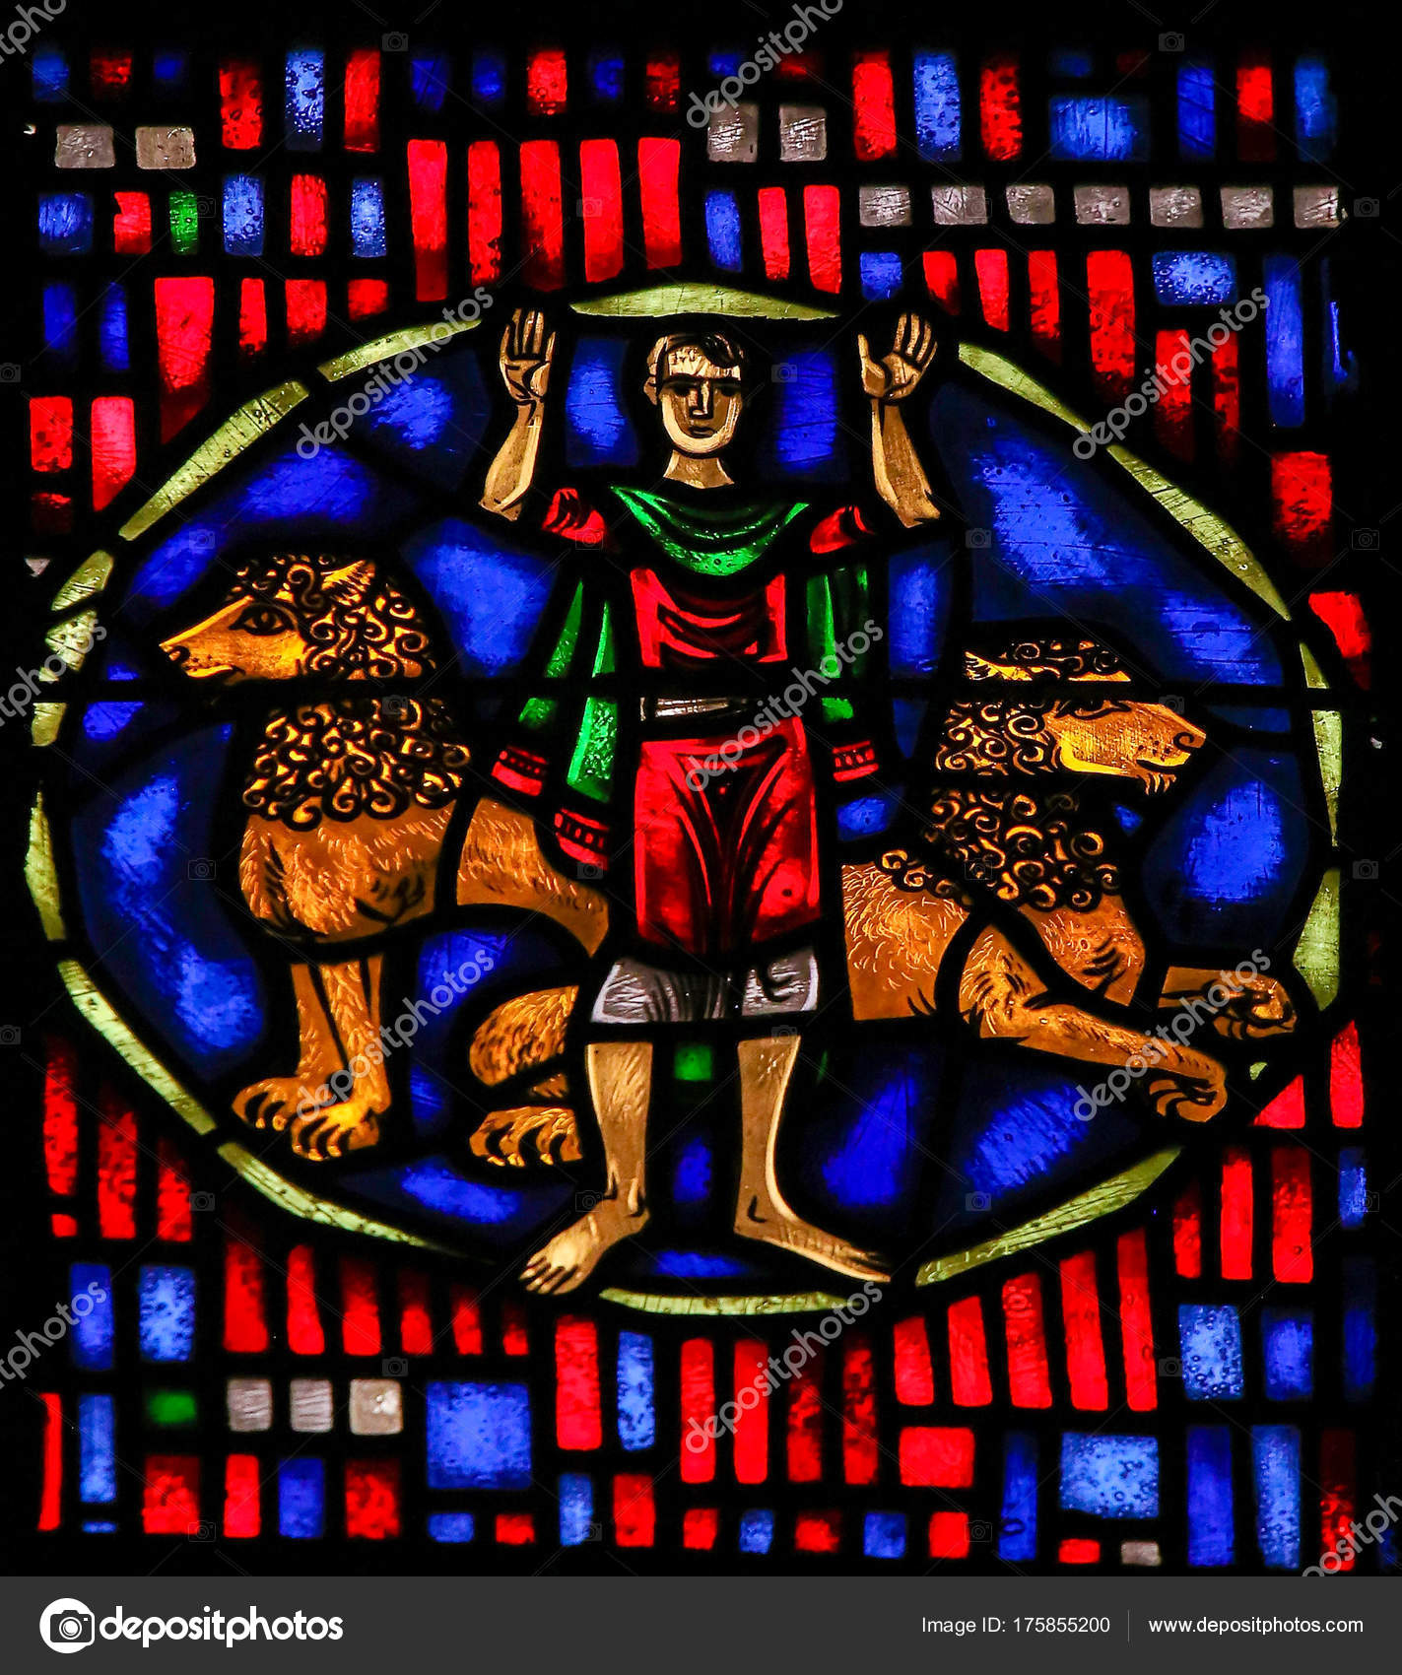
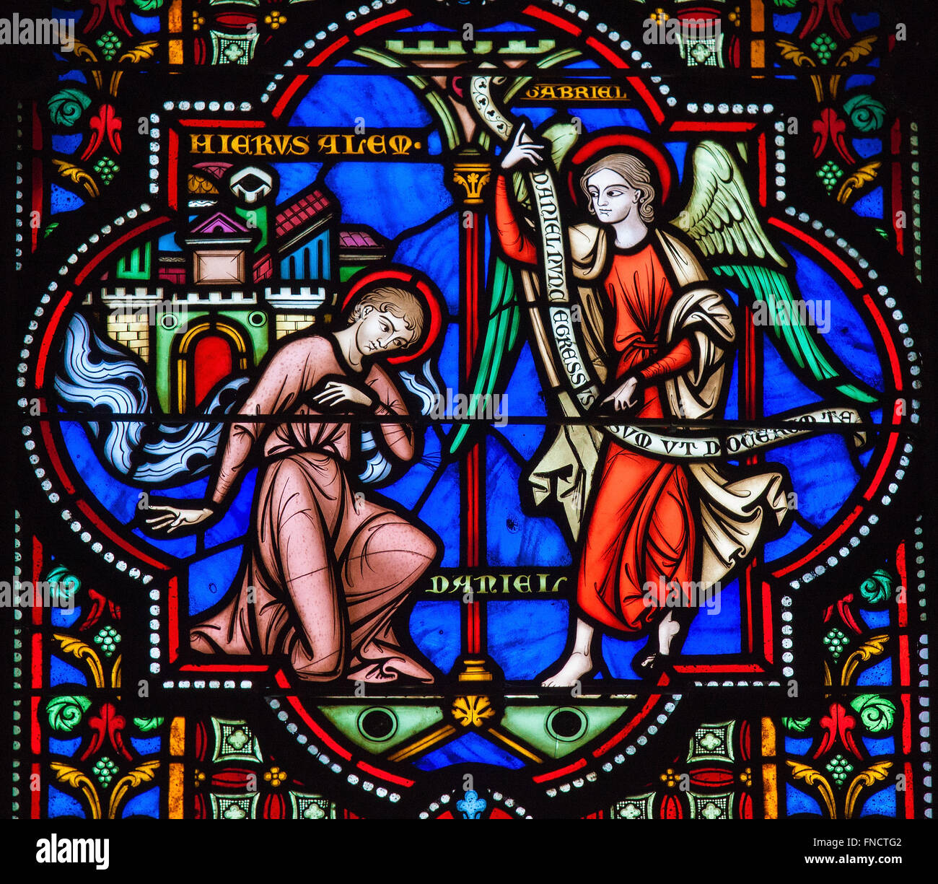
Composition of Daniel
Ch. 1-6 --> folklore Ch. 7-12 --> apocalyptic
1:1-2:4 and 8-12 → Hebrew
2:4b-7:28 → Aramaic

Slide 6
Date
Set in fictionalized Babylonian/Persian empires
Likely written between 167-165 BCE
Reason for accurate historical pinpoint:
Detailed telling of history up to Antiochus IV Epiphanes

Slide 7
Composition
Discussion:
Compare and contrast first and second half of book of Daniel

Slide 8
Composition
 | 1-6 | 7-12
genre | Folktale | apocalyptic
Imperial context | Bungling, foolish kings | Malevolent, destructive kings
danger | Temporary, personal danger for Dan & friends | Warfare, sacrilege, universal destruction
Daniel | Interpreter | Visionary
What saves | Daniel’s wisdom and fidelity to God’s law | God’s mighty intervention

Slide 9
Ch. 1-6: Folklore
Captivity in Babylon
Interpretation of dreams
Fiery furnace
Writing on the wall
Lion’s den

Slide 10
Ch. 1-6: Folklore
Discussion:
Compare and contrast Daniel with other biblical characters (ie Joseph, David, Esther)

Slide 11
Ch. 7-12: Apocalyptic
Dire tribulations of empire
Highly specific visions
Not human obedience, but divine intervention
Secret, hidden meanings

Slide 12
Apocalypse v. Prophecy
Where does it show up in the canon?
 | 1-6 | 7-12
genre | Poetry of intensification | Highly specific vision
timeframe | Future, historical time | END of history—all thing change
openness | Open possibilities | Strictly predictive

Slide 13
Historical Context
Empires of visions:
Babylon
Medians
Persians
Greek
Prime villain:
Antiochus IV Epiphanes

Slide 14
Hellenistic Empire
Conquest of Alexander the Great—333 BCE
Empire divided: Ptolemies (Egypt) and Seleucids (Syria & Mesopotamia)
Conflict over which got control of Palestine
Created factions among Jewish community
Hellenization: expanded Greek language & culture
Greek translation of OT: Septuagint

Slide 15
Antiochus IV Epiphanes
Seleucid king
Conflict over priesthood & temple leadership
Attempt to pay taxes using temple vessels
Riot in Jerusalem—Antiochus conquered
Plundered temple vessels
Installed altar to Zeus/Baal
Suppressed Jewish practies

Slide 16
Moving Forward
Date of last class:
Reading for next time: Jonah, Hosea 11:1-9, II Chronicles 35:20-63:23, Malachi 1-4.
Assignment for next time:
Write the story of the Bible on one page
Opening prayer for next time:

