Slide 1
HO
Exploring the Old Testament:
A Biblical Survey
First Presbyterian Church of Tallahassee
Wednesdays 5:45-6:45 p.m.
Rev. Margaret Fox
Notes:
Pause screen share, welcome class, pray

Slide 2
Prayer for illumination
Tip Tomberlin

Slide 3
Today’s Class
Jeremiah & Ezekiel

Slide 4
What’s new?
Who is God?
Creator, covenant maker, warrior… lawgiver, commander, enforcer, tactician & general, rescuer/punisher, fertility specialist, ark-dweller, kingmaker & king un-maker, dynasty founder, resident of Jerusalem, forgiver & enforcer, restorer of fortunes, divine speaker, vision caster & performance artist
Who is Israel?
Family lineage, slaves, fugitives, covenant people, soldiers & settlers, apostates and tribal lords, open and accepting people, proto-monarchy, monarchy, divided monarchy, people in exile, people returning and rebuilding, people accused & consoled

Slide 5
Jer. & Ez. Compared
Late 7th to early 6th century
Enemy: Babylon
Audience: Judah/Jerusalem
From priestly families
Fall of Jerusalem
Both destruction and hope

Slide 6
Jer. & Ez. Contrasted
Discussion: what differences did you notice in content/style between Jeremiah and Ezekiel?

Slide 7
Jeremiah | Ezekiel
627-587 (active) | 593-571 (active)
Wrote in Jerusalem | Wrote in exile
Non-chronological compilation | Chronological; Ezekiel is author & compiler
Some minor sign-acts | Dramatic sign acts
Social, political, religious | Religious emphasis
Urgent, emotive | Literary (crazy, yet organized!)
Personal torment about prophetic calling | Not much biographical material
Taken to Egypt | Taken to Babylon

Slide 8
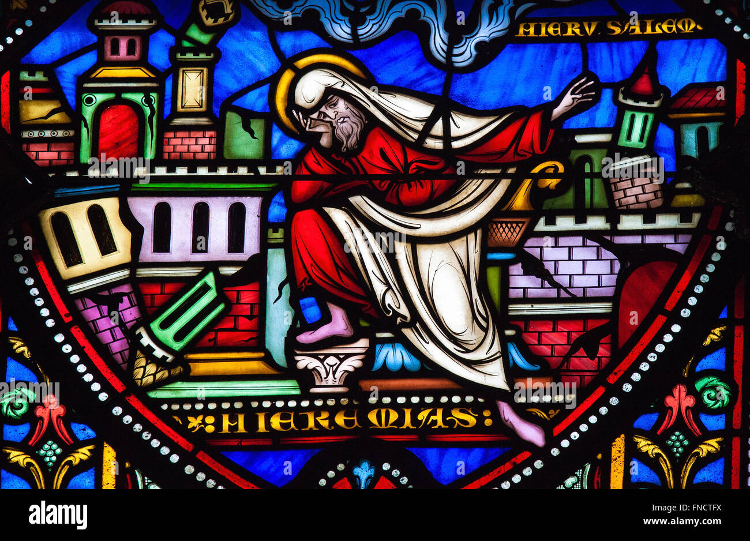
Jeremiah

Slide 9
Contents
Oracles against Judah and Jerusalem
Memoirs of scribe Baruch
Oracles against foreign nations

Slide 10
Outline
1-24: Before exile
Sins: idolatry, leaders abandoned covenant, exploitation
25: Babylon will destroy Israel – 70 yrs exile
26-45: Judgment and hope
26-29: Babylon will destroy
30-33: after exile, renewed covenant & hearts
24-45: siege & destruction

Slide 11
Outline, cont.
46-51: God uses Babylon against neighboring nations
50-51: God will judge Babylon
52: Jerusalem destroyed

Slide 12
Themes
Deuteronomistic outlook
Temple sermon ch. 7
IF you don’t oppress, THEN I’ll dwell w/you
Counterexample: God destroyed Shiloh for Israel’s wickeness

Slide 13
Discussion
What metaphors struck you from Jeremiah?
Which were beautiful? Which were troubling?

Slide 14
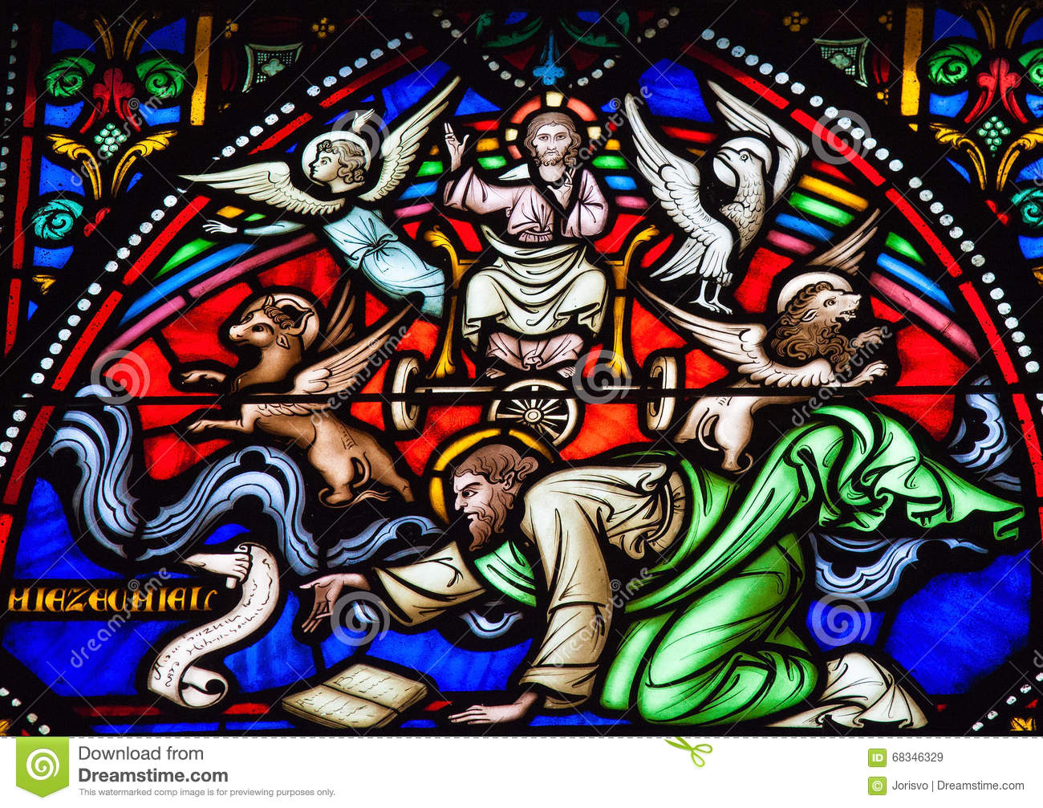
Ezekiel

Slide 15
Organized, yet crazy…
… highly structured and literary, yet full of wild visions and dramatic “sign acts”

Slide 16
Organized (by chronology & content)
1-24: Oracles of doom v. Jerusalem & Judah (593-588)
25-32: Oracles of doom v. foreign nations (587-585)
33-48: Oracles of salvation for Jerusalem (585-573)

Slide 17
Visions
Flaming chariot (“the appearance of the likeness of the glory of the Lord…”) (1)
Temple vision: God’s glory departs (8-11)
Valley of dry bones (37)
Gog and Magog (38-39)
Final temple vision – glory returns (40-43

Slide 18
Sign Acts
Call story: eat this scroll (2-3)
Paralysis; lie on your side (3-4)
Cut hair w/a sword & weigh it (5)
Prep a go-bag (12)
Tremble while eating (12)
Don’t mourn your wife (24)

Slide 19
Allegories
Vine (15)
Adulterous wife (16)
Eagles (17)
Burning forest (20)
Divine sword (21)
Two sisters, Samaria & Jerusalem (23)
Pot (24)

Slide 20
Lamentations
“How lonely sits the city that once was full of people…”

Slide 21
Moving Forward
Assignment for next time:
Indictment metaphor: draft each prophet’s charges against Isr./Judah
Opening prayer for next time: _______

