Slide 1
HO
Exploring the Old Testament:
A Biblical Survey
First Presbyterian Church of Tallahassee
Wednesdays 5:45-6:45 p.m.
Rev. Margaret Fox
Notes:
Pause screen share, welcome class, pray

Slide 2
Prayer for illumination

Slide 3
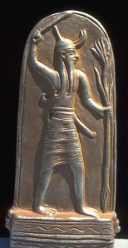
What’s so great about Baal?
Storm god (brought rain)
Defeated gods Mot (death, drought) and Yamm (sea, chaos)
God of agriculture and fertility

Slide 4
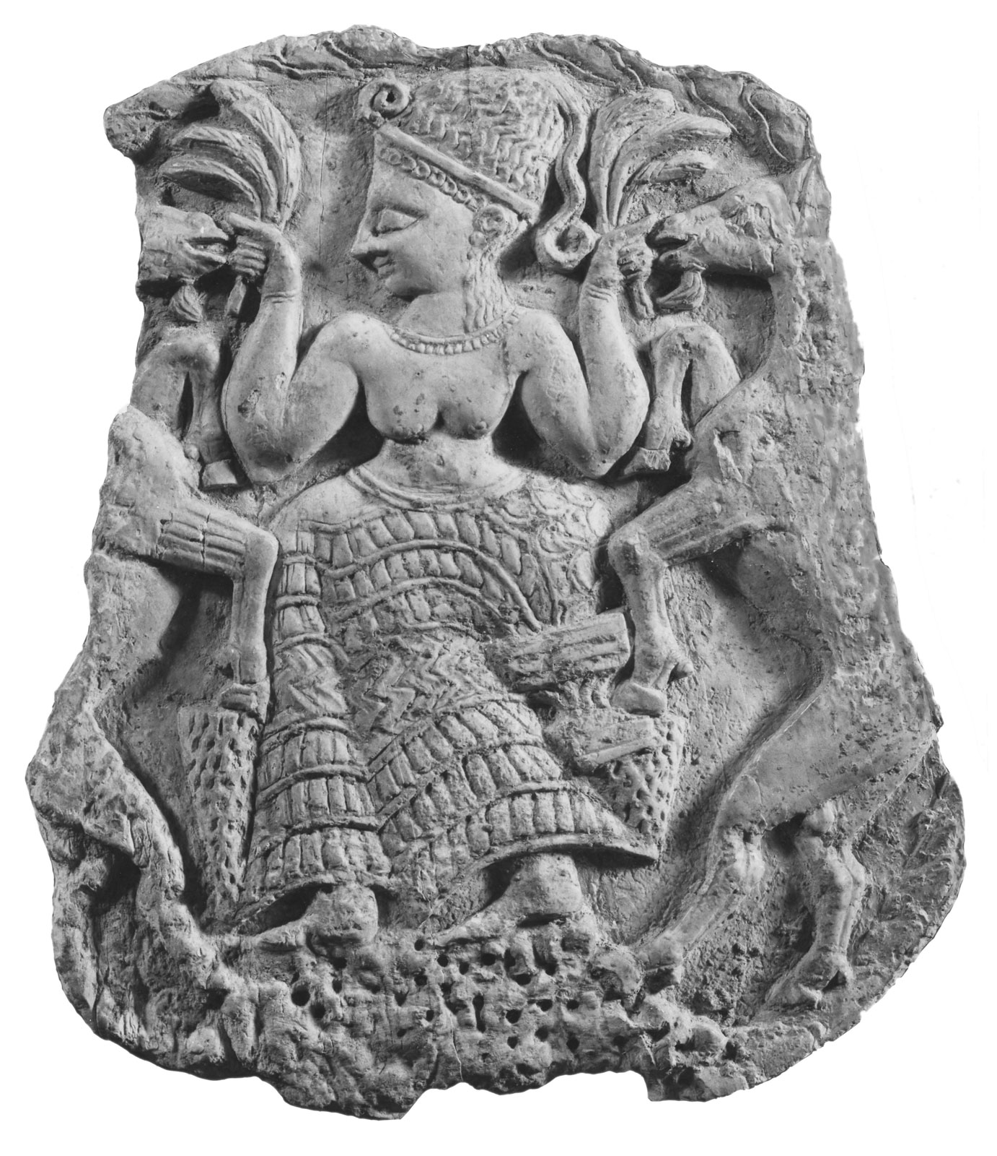
What’s so great about Asherah?
Mother goddess
Association w/fertility

Slide 5
Prostitution
Bible often uses polemically as a metaphor for Israel’s infidelity—makes it hard to identify actual practices
Bible recognized existence of prostitutes, but was generally anti-prostitution
May have been some form of sexual activity/prostitution in Canaanite religions (only the Bible uses language of prostitution to describe this)

Slide 6
Today’s Class
Ezra & Nehemiah
Genre
Imperial context
Outline
Themes

Slide 7
What’s new?
Who is God?
Creator, covenant maker, warrior… lawgiver, commander, enforcer, tactician & general, rescuer/punisher, fertility specialist, ark-dweller, kingmaker & king un-maker, dynasty founder, resident of Jerusalem, forgiver & enforcer, restorer of fortunes
Who is Israel?
Family lineage, slaves, fugitives, covenant people, soldiers & settlers, apostates and tribal lords, open and accepting people, proto-monarchy, monarchy, divided monarchy, people in exile, people returning and rebuilding

Slide 8
Genre
What genres are represented in Ezra/Nehemiah?
How is the style similar to/different from previous books we’ve read?

Slide 9
Genre
Originally one book, but multiple sources
Post-exilic literature: multiplicity of form
Memoir, prayer, narrative, official edict, genealogy
Reference to imperial records
Desire to create contemporaneous historical account

Slide 10
Empires of Exile/Return
North
Assyria
Babylonia
Persia
South
Egypt

Slide 11
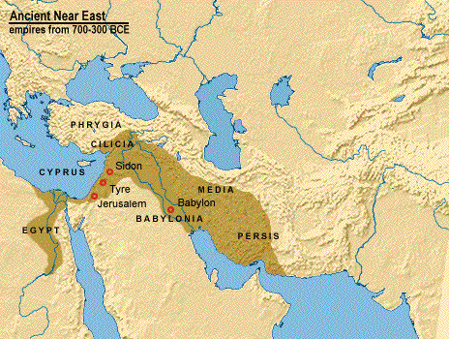
Assyrian (911-609)

Slide 12
Assyria
Capital at Ninevah
Conquered Israel 722 BCE
Bible portrays as brutal
Mission: permanent conquest
Provinces and vassal states
Deportation to control the conquered
Bureaucracy administered by Aramean deportees (rise of Aramaic language)
Prophetic books: ______________
Notes:
Isaiah, Jeremiah, Ezekiel, Hosea
Micah, Nehum, Zephaniah, Zechariah
Jonah

Slide 13
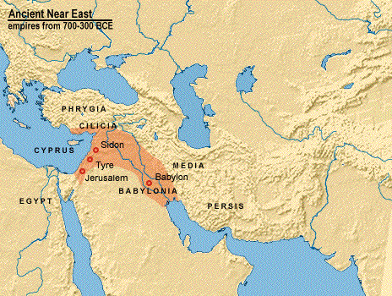
Babylonian (609-539)

Slide 14
Babylon
Nation of learning: astronomers, magi
Advanced agricultural civilization
Portrayed as representing excess of human ambition
Nebuchadnezzar
Conquest of Judah (586)
Prophetic books:______________
Notes:
Daniel, Isaiah, Jeremiah, Ezekiel

Slide 15
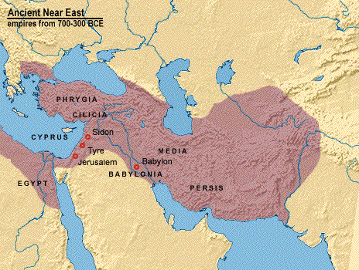
Persian (550-330)

Slide 16
Persia
Policy of respecting local worship practices
Cultural assimilation and religious syncretism
Rulers: Cyrus, Darius, Artaxerxes, etc
Bible portrays as benevolent & tolerant
Biblical books: ________________
Notes:
Ezra, Daniel, Esther
Isaiah

Slide 17
End of Exile
Outline:
2 Chronicles 36 ends w/Edict of Cyrus
Ez. 1-2 First two stages return
Ez. 3-6 Rebuilding altar, temple
Ez. 7-10 Ezra’s mission
Neh. 1-7 Nehemiah’s return, rebuilding walls
Neh. 8-9 Torah reading & observance
Neh. 10 Covenant
Neh. 11 Repopulation
Neh. 12-13 Purification & separation

Slide 18
4 Phases of Return
Emperor | Date/Range | Jewish Leader | Accomplishments
Cyrus | 538 | Sheshbazzar | Started temple
Darius I | 521-485 | Zerubbabel & Jeshua Haggai & Zechariah | Completed temple
Artaxerxes I | 464-423 | Ezra | Codify Mosaic law
Artaxerxes I | 445 | Nehemiah | Build walls Enforce purity of community & worship

Slide 19
Dynamics of Rebuilding
Persian King
Existing occupants
Newly returning group

Slide 20
Dynamics of Rebuilding
Commissioning by Persian king
List, leadership, credentials of returning party
Undertake project
Yet face opposition
Who is already in the land?

Slide 21
Who is already in the land?
People settled in the North by Assyrians (Samaritans)
Province “Beyond the River”
Poor people who remained to work land during Babylonian captivity
Neighboring peoples

Slide 22
Opposition
Accusation that walls = independence
Complaint of economic hardship
Competing claims of title to land
Sabotage of building project

Slide 23
Themes of Rebuilding
Homework discussion: What were the center and edges (literal and metaphorical) of the returning society?

Slide 24
Moving Forward
Assignment for next time: selections from Isaiah
Opening prayer for next time: _______

