Slide 1
Exploring the Old Testament:
A Biblical Survey
First Presbyterian Church of Tallahassee
Wednesdays 5:45-6:45 p.m.
Rev. Margaret Fox
Notes:
Pause screen share, welcome class, pray

Slide 2
Prayer for illumination
?

Slide 3
Today’s class:
Judges
The conquest: Squid Game version
Notes:
START with homework questions

Slide 4
“Things fall apart; the centre cannot hold;
Mere anarchy is loosed upon the world,
The blood-dimmed tied is loosed….”
--Yeats, “The Second Coming,” qtd in Alter, The Hebrew Bible vol. 2
Notes:
START with homework questions

Slide 5
“In those days there was no king in Israel; all the people did what was right in their own eyes.”
--Judges 21:25
Notes:
START with homework questions

Slide 6
What’s new?
Who is God?
Creator, covenant maker, warrior… lawgiver, commander, enforcer, tactician & general, rescuer/punisher
Who is Israel?
Family lineage, slaves, fugitives, covenant people, soldiers & settlers, apostates and tribal lords

Slide 7
Continuity – Judges. 1:1
After the death of Joshua, the Israelites inquired of the Lord, ‘Who shall go up first for us against the Canaanites, to fight against them?’

Slide 8
Main issue: apostacy
Because Canaanites remained in the land, Israel followed their gods (Baal, Astartes – fertility)

Slide 9
Deuteronomistic History
Agenda:
Centralized worship at Jerusalem temple
Absolute separation of Canaanites & Israelites

Slide 10
Summary
Two Introductions
1. Foreign wars
2. Foreign idols
Cycles of Judges
Two Conclusions
1. Domestic idols
2. Domestic wars

Slide 11
Two Introductions
Foreign wars:
Angel of the Lord says, “because you made covenants w/inhabitants of the land, I will not drive them out; they will be adversaries to you, and their gods will be a snare to you.” (2:2-3)

Slide 12
Two introductions
Foreign idols: cycle of apostacy
Isr. does evil, abandons God, worships Baals
God gives them over to oppressors for x years
Israel cries to God
God raises a judge
“Spirit of the Lord” is upon the judge (even if a not-good guy)
Oppressor is subdued
Land rests x years

Slide 13
Cycle of Judges
“Judges” as ad-hoc, charismatic leaders
Not primarily judicial—also military and political
(Deborah has specific judicial role)
“Judge” is a verb: “so-and-so judged Israel…”
Increasingly corrupt & compromised

Slide 14
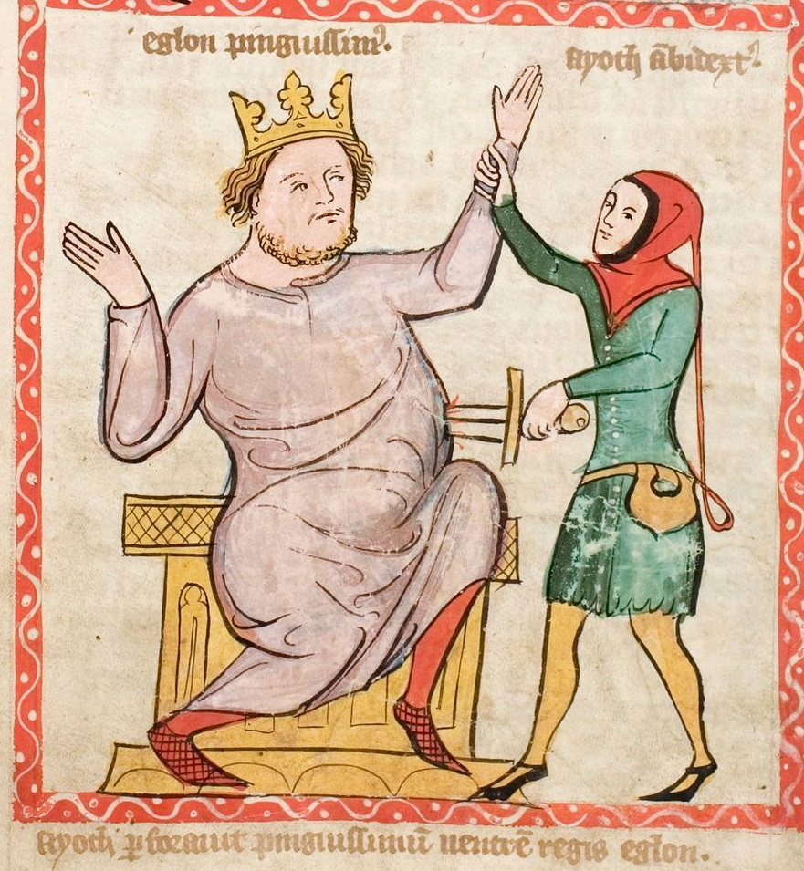

Slide 15
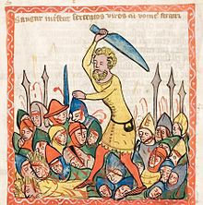

Slide 17
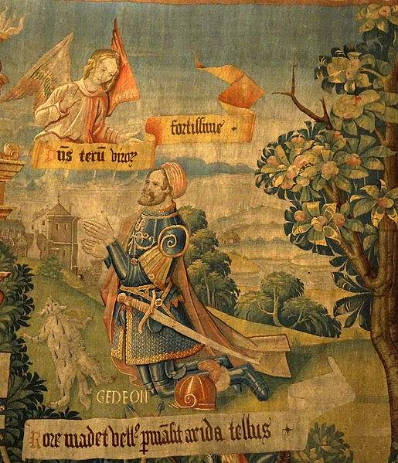

Slide 19
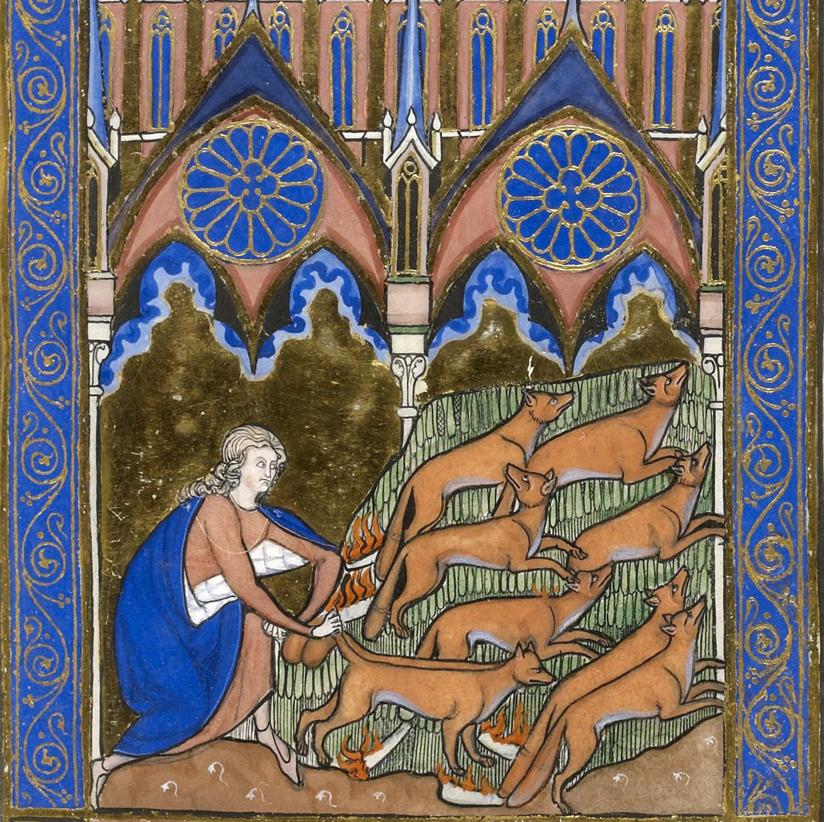
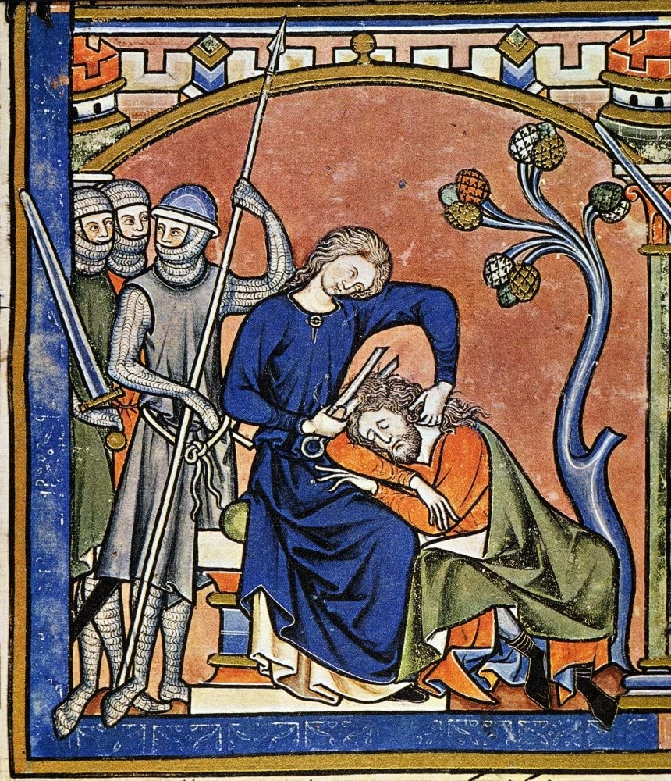

Slide 20
Two Conclusions
Domestic idol: Micah builds, Levite serves
Story of the Levite’s concubine
(Note changes in narration and tone)

Slide 21
Question
Name two stories in Judges that have parallels in Genesis. How are the outcomes different here?

Slide 22
Rachel Held Evans on violence in Judges:
“Not every character stuck with the script…”
Women mourn Jephthah’s daughter
Deborah names mourning mother of opponent

Slide 23
Rachel Held Evans on violence in Judges:
“If you pay attention to the women, a more complex history of the conquest emerges… If the Bible’s texts of terror compel us to face with fresh horror and resolve the ongoing oppression and exploitation of women, then perhaps these stories do not trouble us in vain…”

Slide 24
Rachel Held Evans on violence in Judges:
If Jesus is the Bible’s ultimate revelation, “then God would rather die by violence than commit it…”
--Inspired: Slaving Giants, Walking on Water, and Loving the Bible Again

Slide 25
Moving Forward
Theme for next week: conquest v2
Assignment for next week:
Where is God?
AND
Where is the book of Ruth in the Bible?
Opening prayer for next week: _______

