Slide 1
Exploring the Old Testament:
A Biblical Survey
First Presbyterian Church of Tallahassee
Wednesdays 5:45-6:45 p.m.
Rev. Margaret Fox
Notes:
Pause screen share, welcome class, pray

Slide 2
Prayer for illumination
?

Slide 3
Today’s class:
Joshua
The conquest:
“Mission Accomplished” version
Notes:
START with homework questions

Slide 4
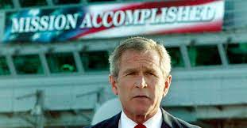
Notes:
START with homework questions

Slide 5
What’s new?
Who is God?
Creator, covenant maker, warrior… lawgiver, commander, enforcer, tactician & general
Who is Israel?
Family lineage, slaves, fugitives, covenant people, now soldiers & settlers

Slide 6
Continuity – Josh. 1:1
After the death of Moses the servant of the Lord, the Lord spoke to Joshua son of Nun, Moses’ assistant, saying, “My servant Moses is dead. Now proceed to cross the Jordan, you and all this people, into the land that I am giving to them, to the Israelites. Every place that the sole of your foot will tread upon I have given to you, as I promised to Moses.”

Slide 7
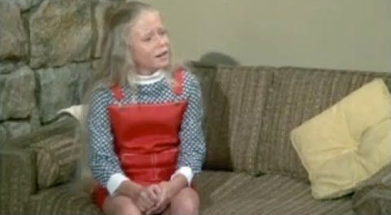
Continuity
Moses, Moses, Moses!
Question:
How does the text establish Joshua
as successor to Moses?
Notes:
Lead out of Egypt/lead into promised land
Crossing of Red Sea/Jordan
Spies to Canaan/spies to Jericho
Allotment of land: Moses—Transjordan, Joshua, cisjordan
Covenant at Sinai/covenant at Shechem

Slide 8
What’s missing
Triangulated relationships/mutual irritability/moral complexity:
Josh. 4:14: “On that day the Lord exalted Joshua in the sight of all Israel; and they stood in aw of him, as they had stood in awe of Moses, all the days of his life.”
Notes:
This is less nuanced, sharper, neater. God is clear on covenant expectations, less arbitrary, swift to correct/enforce. Joshua is unambiguously heroic—he has some lapses, but way less colorful than Moses

Slide 9
Deuteronomistic History
Joshua – 2 Kings (Deuteronomy as prologue)
Particular historical/theological perspective that shapes the narrative
Arose during period btw. Conquests
721-589 BCE
Reforms of King Josiah, “re-discovery” of book of Deuteronomy
Covers: Moses-Exile (about 1200 – 500 BCE)

Slide 10
Deuteronomistic History
Agenda:
Centralized worship at Jerusalem temple
Absolute separation of Canaanites & Israelites

Slide 11
Themes
Herem—the practice of total destruction
Etiology—explanation of why Canaanites remain
E.g. Rahabites, Gibeonites, etc.
Condemnation of idolatry—sin of Achan
Cis-Jordan v. trans-Jordan

Slide 12
The good news:
The archaeology does not support the narrative
Notes:
Most of these cities were unoccupied at the time of the conquest

Slide 13
Summary
Joshua 1-12: Conquest
1-5: Preparations
Commissioning/authorization
Spies to Jericho
Cross Jordan, build memorial
Circumcision
5-12: Campaigns
Notes:
End screen and talk about campaigns. Homework question: what did you notice from map-drawing assignment?

Slide 14
“The prevailing sense, however, of the first half of the book is ruthlessness, and the general effect of the second half is tedium.” --Robert Alter

Slide 15
Summary
Joshua 13-24: Allotments
13-21: Allotment
Follow-up on Numbers:
Caleb, Zelophedad’s daughters
Tent of meeting at Shiloh
Cities of refuge & Levitical cities
22-24: Epilogue
Conflict over altar/memorial
Joshua’s final speech; covenant renewal

Slide 16
Small Group Discussion
Insights from homework assignment?
Reading: what was surprising? troubling?
Reflect: how have these texts been used to justify conquest? What does it feel like to read them today?

Slide 17
Moving Forward
Theme for next week: conquest v2
Assignment for next week: trading cards
Warning for next week: Judges 19 is awful.
Opening prayer for next week: _______

