Slide 1

Exploring the Old Testament:
A Biblical Survey
First Presbyterian Church of Tallahassee
Wednesdays 5:45-6:45 p.m.
Rev. Margaret Fox
Notes:
Pause screen share, welcome class, pray

Slide 2

Prayer for illumination
Marian Moore

Slide 3
Homework Reflections

Slide 4
Audio Clip
    The Ezra Klein Show: Interview with Maggie Nelson from Oct. 8, 2021
Notes:
Play starting at 25:42-27:27, 31:04 – 32:52

Slide 5
Maggie Nelson interview
  “I have long been a fan of unchaperoned experiences of life and art…”
  “I have always felt disobedient about being told what something means…”
  “deep hunger for a tool with no blood on it…”
  “noticing what that desire is for and how it doesn’t link up with the world of crazy, wild, imperfect, traumatized, damaged, beautiful humans that we live in…”
Notes:
Play starting at 25:42-27:27, 31:04 – 32:52

Slide 6
Today’s class:
Exodus 1-18
Lecture: What’s in it?
Large group: How do we read it?
Small group:
Notes:
START with homework questions

Slide 7
What’s new?
Danger! … a very bloody story
Continuity and contrast with Joseph story

Slide 8
Continuity
  Plot (1:1 “These are the names of the sons of Israel who came to Egypt with Jacob…)
  Setting
  Characters
  Theme of deliverance

Slide 9
Contrast
  Direction (toward Egypt v. away)
  Egyptian regime (1:8 “the new king did not know Joseph…”)
  Economic activity (urban/agrarian v. pastoral)
  Theological style (SO MUCH divine speech)
  Level of explicit violence
  Worship orientation
Notes:
ASK: where else did you see continuity/contrast?

Slide 10
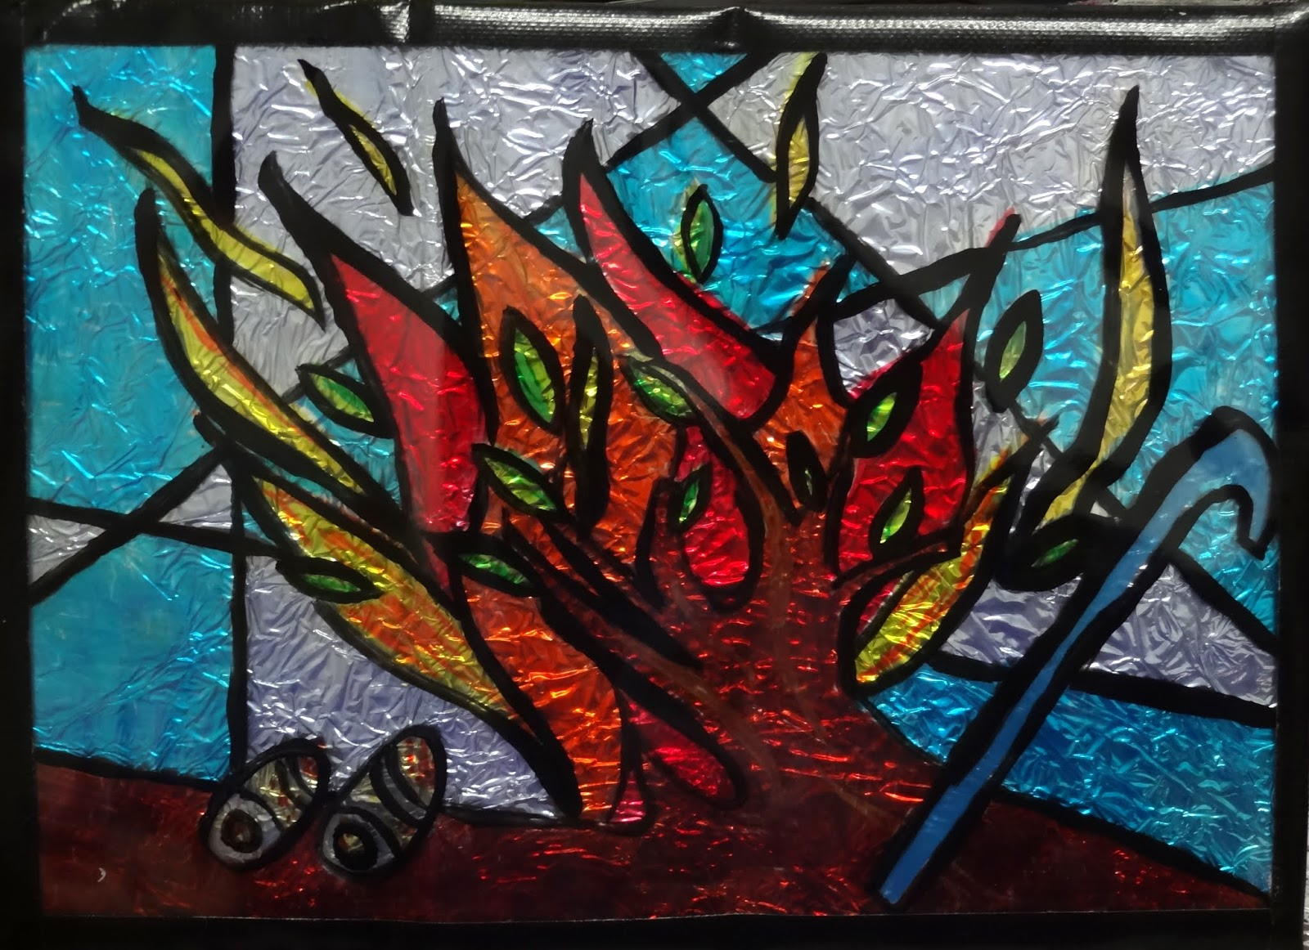
Themes
  Complaint
  Covenant (God remembers…)
  Call of Moses
  Correspondence btw. Moses’ journey & people’s journey

Slide 11
Summary
  Enslavement & oppression; threat to firstborn
  Heroic acts of resistance
  Birth, childhood, formation of Moses; call
  Conflict with Pharoah; 10 plagues
  Final plague and flight
  Origins of Passover
  Parting of the Red Sea
  Triumphant song of Moses (ch. 15)
  Wilderness beginnings
Notes:
ASK: what was it like to sing that song?

Slide 12
Large Group Discussion
  What do we do with this tool that has blood on it?
Notes:
Play starting at 25:42-27:27, 31:04 – 32:52

Slide 13
Small Group Discussion
Insights from homework assignment?
Reading: what was surprising? troubling?
Reflect: what was your stance toward the text this time around?

Slide 14
Moving Forward
  Theme for next week: Legislative history
  Assignment for next week: Block out the story
  Opening prayer for next week: _______
Notes:
This is the founding presupposition of this class—that there is some whole worth exploring

