Slide 1
Exploring the Old Testament:
A Biblical Survey
First Presbyterian Church of Tallahassee
Wednesdays 5:45-6:45 p.m.
Rev. Margaret Fox
Notes:
Pause screen share, welcome class, pray

Slide 2
Prayer for illumination
Bo Elzie

Slide 3
Today’s class:
Gen. 37-50
Outline & themes
Large group: Genesis 41
Small group

Slide 4
Genre of Genesis 37-50
Fictionalized narrative
$≠$ “made up”
= highly stylized, literary

Slide 5
The Art of Biblical Narrative by Robert Alter
“The conception of biblical narrative as prose fiction… entails an emphasis on delicate artistry and even playfulness that may seem a little odd according to common notions, both popular and scholarly, of what the Bible is….”
Cf. prophecy:
direct, unmediated discourse
God’s reported speech
often takes poetic form

Slide 6
The Art of Biblical Narrative cont.
“It is obvious enough why the prophets should have used poetry, with its resonances, emphases, significant symmetries and forceful imageries, to convey their vision, for prophetic poetry is a form of direct address that is heightened, made memorable and almost inexorable through the rhetorical resources of formal voice.
“By contrast, biblical narrative… is indirect discourse on those objects.”

Slide 7
The Art of Biblical Narrative cont.
“It seems to me plausible enough to assume, as I suggested earlier, that the makers of biblical narrative gave themselves to these various pleasures of invention and expression because, whatever their sense of divinely warranted mission, they were, after all, writers, moved to work out their vision of human nature and history in a particular medium, prose fiction, over which they had technical mastery, and in the medium of which they found continual delight.”

Slide 8
Technical Mastery & Continual Delight
More free, less formulaic than folklore
Characterization through dialogue
Zooming in and out—sweep vs. detail
Emotions, close-ups, memory, inner speech
Word play
Repetition of motifs
Omniscient narrator (wtf?) sometimes flaunts, sometimes withholds

Slide 9
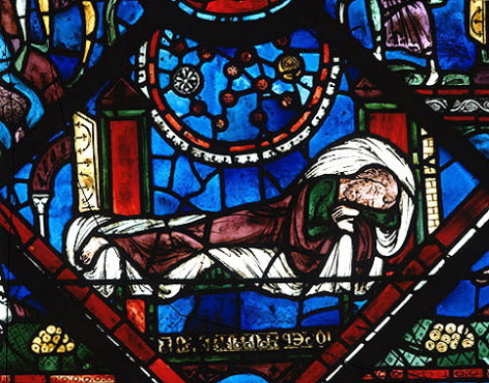
Themes of Genesis 37-50
Dreams
Deception
Destiny

Slide 10
Genesis 37-50 Outline
37 Joseph sold into slavery
38 Judah and Tamar
39-41 Joseph’s career in Egypt
42-48 Family reunion
49-50 Jacob’s blessing, death of Jacob and Joseph

Slide 11
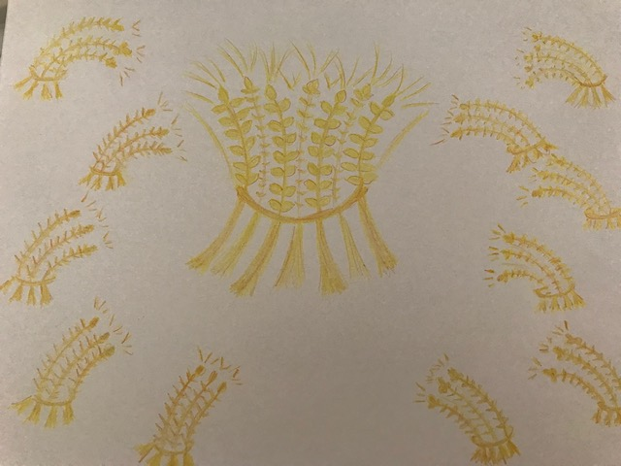
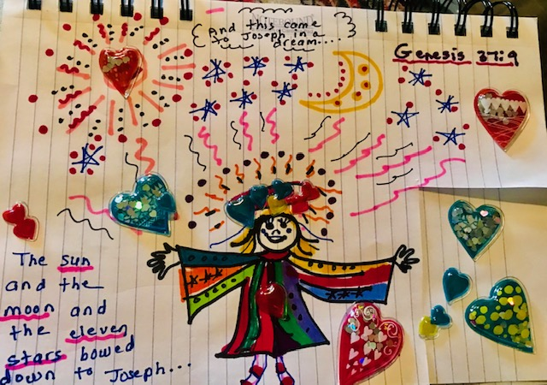
Joseph Sold into Slavery
“Jacob settled in the land where his father had lived as an alien…”
Joseph’s dreams; brothers’ anger
Jacob deceived by sons (irony)
Stage set for descent to Egypt

Slide 12
Judah and Tamar
Feels random
BUT: thematic connection to story
Deception
Danger
Sexual wiles
Identity revealed

Slide 13
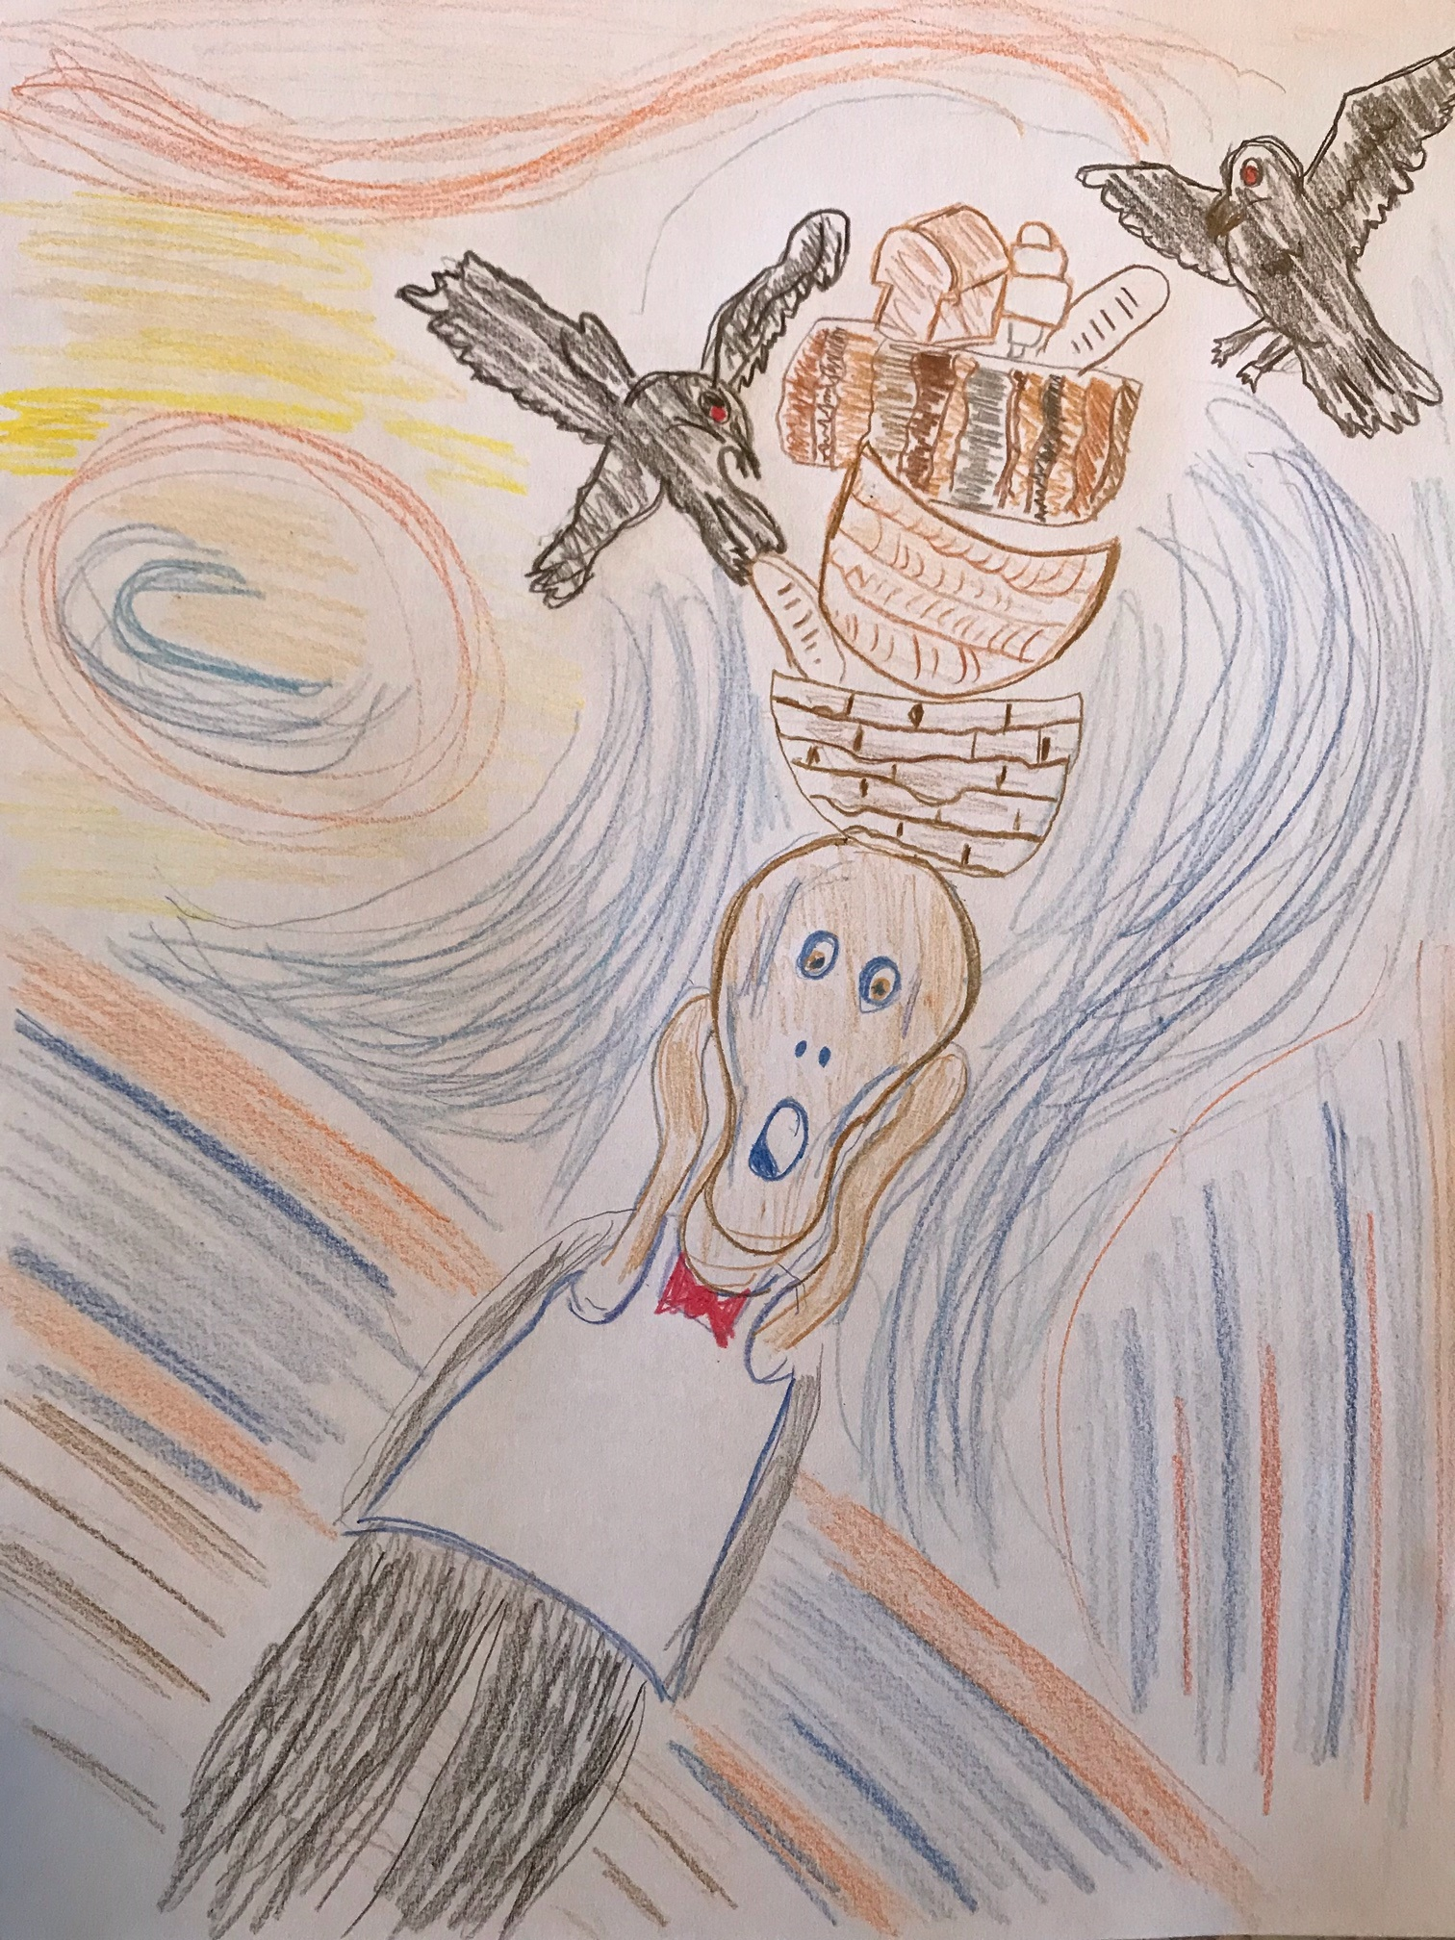
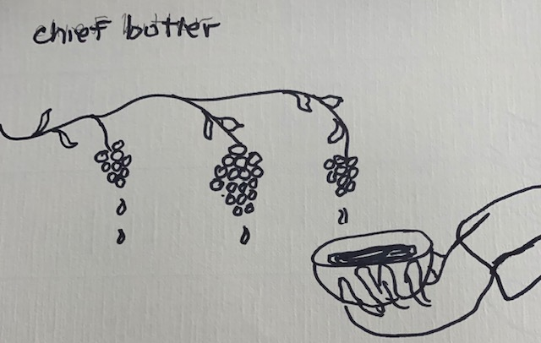
Joseph in Egypt
Potiphar’s house
False accusation
Jail; two more dreams

Slide 14
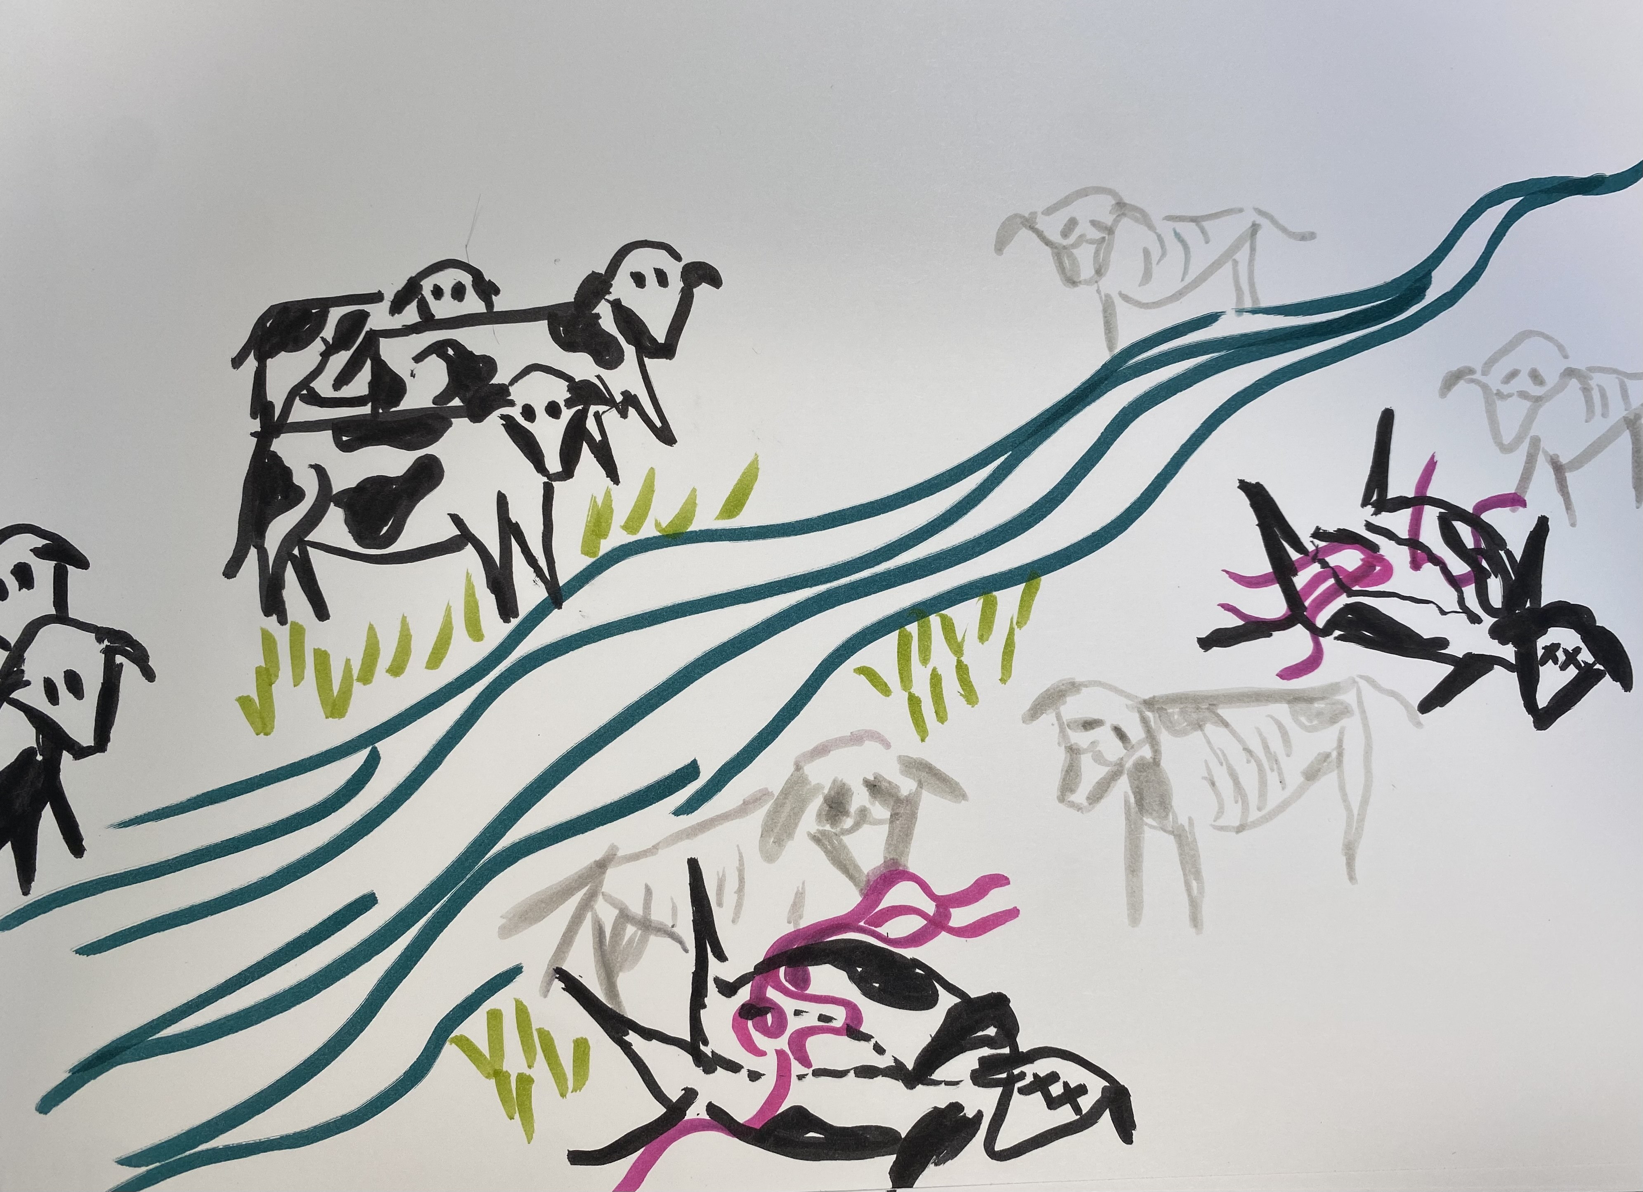
Pharaoh’s Dreams

Slide 15
Joseph in charge
Pharaoh has dreams, butler remembers
Shaves and changes
Writes his own job description
Rises to prominence
World’s first economist
New name, job, wife

Slide 16
Return of the brothers
Extended, emotional process
Manipulation and deception
Also love and reconciliation

Slide 17
Endings
Blessing of Pharaoh, Joseph’s sons, Jacob’s sons
Death and burial of Jacob (in Canaan)
Death of Joseph (bones remain)

Slide 18
“Moral” of the story:
Ch. 50 v. 20: “Even though you intended to do harm to me, God intended it for good, in order to preserve a numerous people, as he is doing today…”

Slide 19
Large Group Discussion
Genesis 41
What do we learn about dreams in this chapter?
What do the dreams predict and do?
Notes:
This is the founding presupposition of this class—that there is some whole worth exploring

Slide 20
Small Group Discussion
Insights from dream assignment?
Reading: what was surprising? troubling?
Providence behind the scenes:
Is this how it all works?

Slide 21
Moving Forward
Theme for next week: danger & deliverance
Assignment for next week:
Sing chapter 15
Opening prayer for next week: _______
Notes:
This is the founding presupposition of this class—that there is some whole worth exploring

