Slide 1
Exploring the Old Testament:
A Biblical Survey
First Presbyterian Church of Tallahassee
Wednesdays 5:45-6:45 p.m.
Rev. Margaret Fox
Notes:
Pause screen share, welcome class, pray

Slide 2
Prayer for illumination
Janet Fixel

Slide 3
Getting Started
Welcome new members
Two cents
Homework reflections

Slide 4
Today’s class:
Gen. 12-36
Outline & themes
Large group: Genesis 17
Small group

Slide 5
Genres of Genesis 12-36
History
Story
Genealogy – etiology – ethnography
Spare (call of Abram) / novelistic (meeting Rebekah)
Zooms in and out

Slide 6
Themes of Genesis 12-36
Land
Descendants
Blessing
… & the things that imperil them!

Slide 7
Genesis 12-36 Outline
12-20 Abraham
21-24 Isaac
25-35 Jacob and sons
… lots of overlap—these are family stories, not reigns of kings

Slide 8
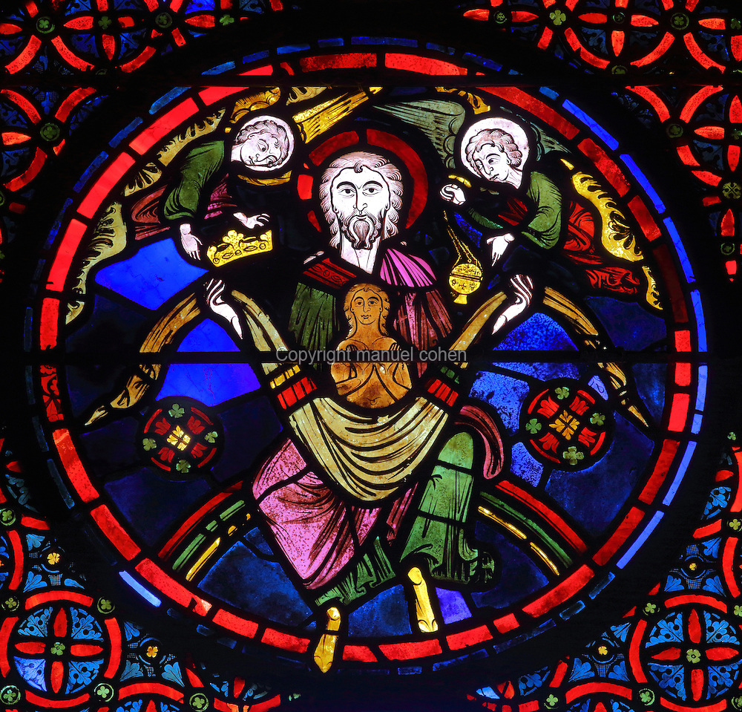
Abraham
Defining the relationship
Call (ch. 12)
Conversation (ch. 15)
Covenant (ch. 17)
Perils
Famines, wife = sister (twice!)
war, kidnapping, old age, jealousy
Exile of Ishmael, sacrifice of Isaac
Fulfillment
Birth of Isaac
What happens to the mess?

Slide 9
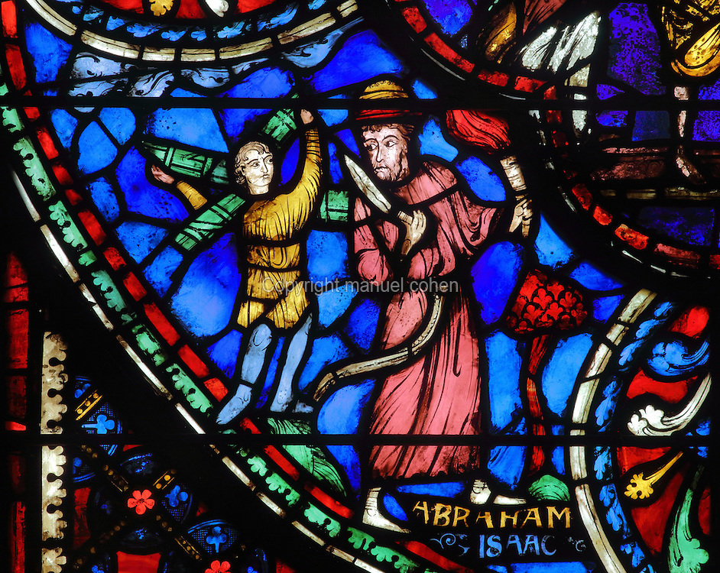
Isaac
Land
Prosperity and wealth
Well-digging
Perils: famine; conflict w/neighbors over wells
Descendants
Romantic comedy of Isaac & Rebekah
Twins Jacob & Esau
Perils: “my wife is my sister”; conflict between sons; bitter Hittite daughters-in-law
Blessing
Blessing at Beer-sheba (Isaac digs a well)
Perils: blessing trickery

Slide 10
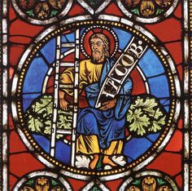
Jacob
Land
Settles in Bethel
Perils: flees to Padanaram, gets trapped there
Descendants
2 wives, 2 concubines, 12 sons, 1 daughter
Name change to Israel; sons are 12 tribes
Perils: jealousy of wives, Ruben sleeps w/Bilhah
Blessing
Tricks his father for it
Receives it in a dream
Wrestles it from God
Receives it in Bethel

Slide 11
Overall Insights
Covenant made, imperiled, renewed, inherited
Underdogs and younger sons
God’s purposes and human freedom

Slide 12
Design & Disorder, Providence & Freedom
“The ancient Hebrew writers… seek through the process of narrative realization to reveal the enactment of God’s purposes in historical events. This enactment, however, is continuously complicated by a perception of two, approximately parallel, dialectical tensions. One is a tension between the divine plan and the disorderly character of actual human events, between the divine promise and its ostensible failure to be fulfilled; the other is the tension between God’s will and human freedom.”
-- Robert Alter, The Art of Biblical Narrative

Slide 13
Large Group Discussion
Genesis 17
What is promised in this chapter?
How do these expectations match/not match the reality that follows?
Notes:
This is the founding presupposition of this class—that there is some whole worth exploring

Slide 14
Small Group Discussion
Insights from family tree assignment?
Reading: what was surprising? troubling?
What is reconciled and what stays broken?

Slide 15
Moving Forward
Theme for next week: providence
Assignment for next week:
Draw a picture of each dream
Opening prayer for next week: _______
Notes:
This is the founding presupposition of this class—that there is some whole worth exploring

Slide 16
Passageway
“It is not the right human thoughts about God which form the content of the Bible, but the right divine thoughts about humans. The Bible tells us not how we should talk with God but what God says to us; not how to find the way to God, but how God has sought and found the way to us; not the right relationship in which we must place ourselves to God, but about the covenant which God has made with all who are Abraham’s spiritual children…”
-- Karl Barth, “The Strange New World within the Bible”

