Slide 1

“Recounting the intertwined histories of families, tribes, and nations, the Bible goes forward and then circles back, takes detours and rabbit trails, leaves some parts out and tells others twice. It is chockful of details, some major, some minor, some puzzling and often astonishing—a patchwork quilt of vastly different times and places, of authors both known and anonymous.”
-- Richard Foster, Life with God

Slide 2

Exploring the Old Testament:
A Biblical Survey
First Presbyterian Church of Tallahassee
Wednesdays 5:45-6:45 p.m.
Rev. Margaret Fox
Notes:
Pause screen share, welcome class, pray

Slide 3
Prayer for illumination
Virginia Thomas

Slide 4
Getting Started
Homework reflections

Slide 5
Today’s class:
Gen. 1-11
Genre and sources
Outline
Large group: Genesis 3
Intro to small group time

Slide 6
Genre of Genesis 1-11
Primeval literature
  Not linked to specific dates/places
  Impression of realism, but stories are timeless
  Myth
    Does NOT mean made up/fictional
    Means contains essential truths, set at beginning of culture, often etiological

Slide 7
Old Testament Sources
“Documentary hypothesis” -- Julius Wellhausen
  J: Yahwist (lively, vivid, creative—promise/fulfillment theme)
  E: Elohist (n. kingdom, independent traditions)
  D: Deuteronomist (7th cent.; fear/love of God; obedience to divine commands; exhortation)
  P: Priestly (post-exilic editor; cult and ritual; genealogy; presence of God in glory/tabernacle)

Slide 8
Genesis 1-11 Outline
1: Creation – order out of chaos
2: Creation – hands-on artisanship
3-5: Disorder and estrangement
6-9: Flood – starting over
10: Table of nations
11: Babel and diaspora

Slide 9
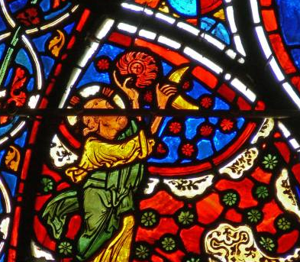
Genesis 1
“In the beginning when God created the heavens and the earth…”
Cosmic
Orderly – seven days
Creation by fiat “let there be light!”
Positive command to eat all plants/trees
“Be fruitful and multiply”
Sabbath

Slide 10
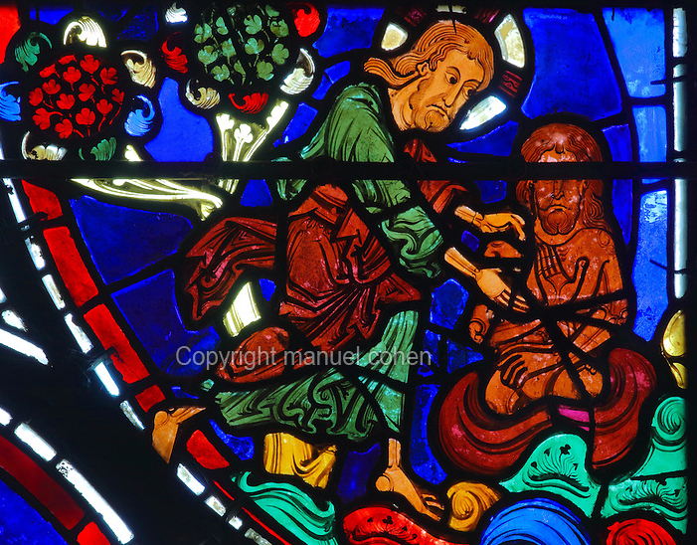
Genesis 2
Garden of Eden
Narrative flow vs. structure
No chronology
Creation by God’s artisanal activity
Trial and error
Prohibition against eating one tree
Ends w/couple naked and unashamed
Similarities:
  Earth, water; plants and animals;
  Procreation and food

Slide 11
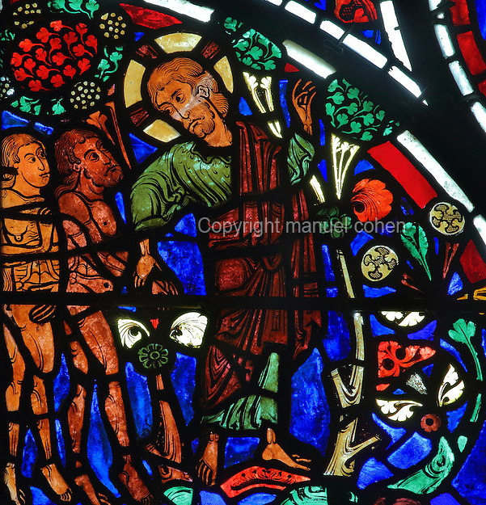
Disorder and estrangement
Ch. 3: Disobedience (Snake!)
Ch. 4: Fratricide
(Cain & Abel)
Ch. 5: Genealogy

Slide 12
Genesis 5 Genealogy

Slide 13
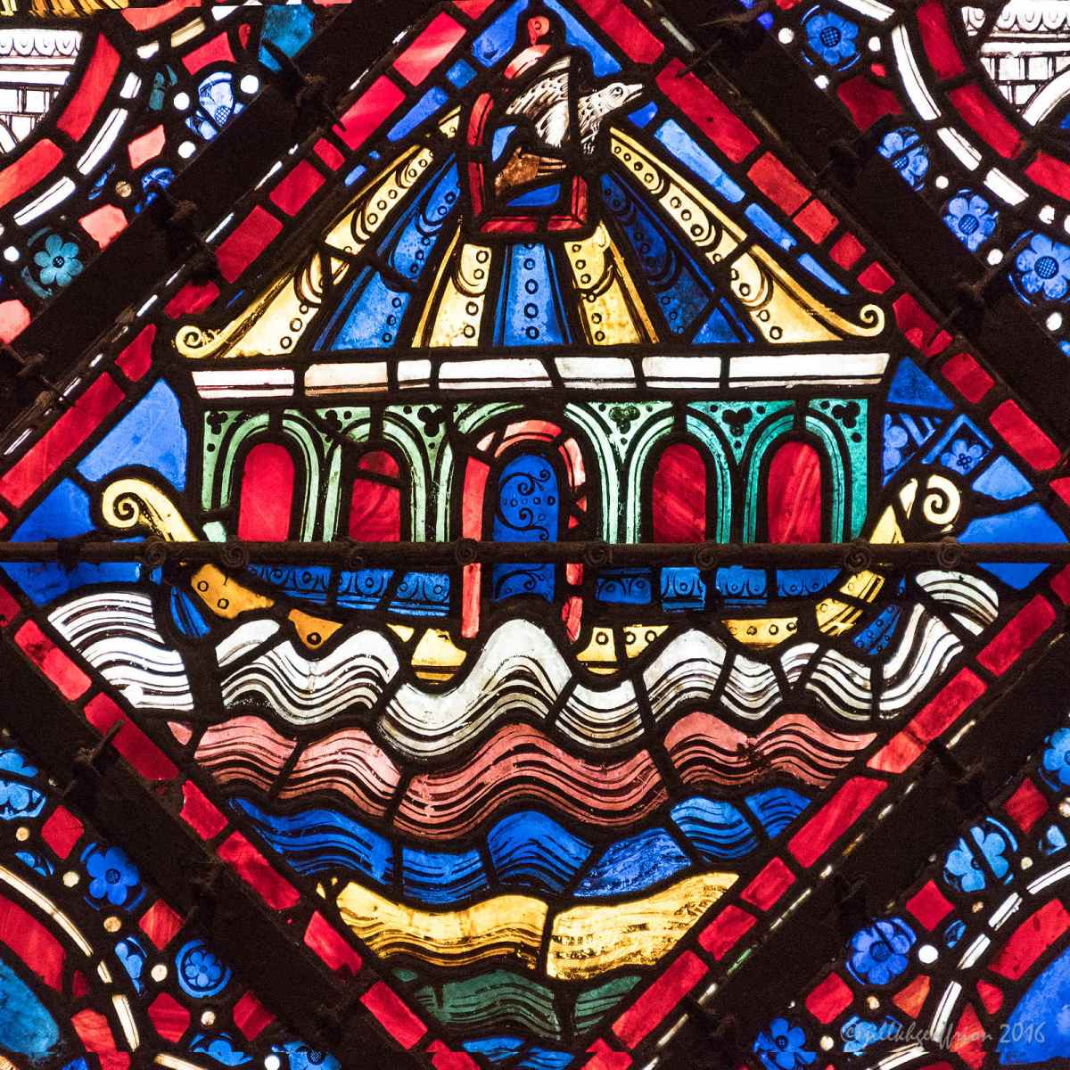
Flood
Nephilim
“God was sorry he had made humankind…”
Contradictions in story:
  How many animals?
  Mechanism of flood?
  Duration of flood?
Outcome of story:
  Sacrifice
  Blessing, meat-eating, murder, covenant
  Drunken Noah, curse of Canaan

Slide 14
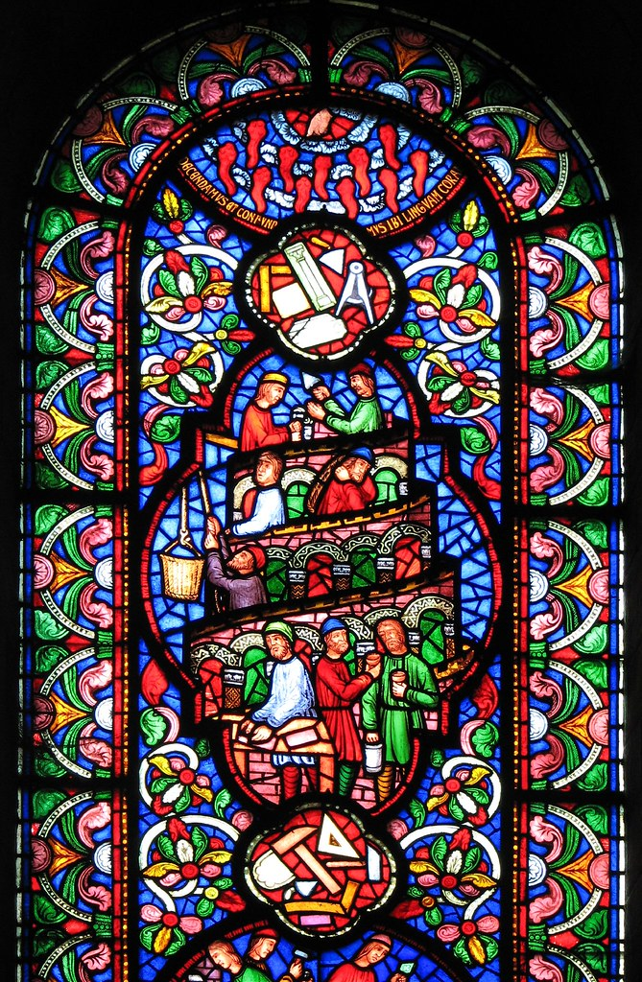
Babel and Diaspora
Ch. 10: Table of Nations
Ch. 11: Tower of Babel

Slide 15
Overall Insights
Role of language from Genesis to Babel
Begins in a garden, ends in a city
Quest for immortality constantly foiled

Slide 16
Large Group Discussion
Genesis 3
Notes:
This is the founding presupposition of this class—that there is some whole worth exploring

Slide 17
Small Group Discussion
Insights from Bible summary assignment?
Reading: what was surprising? Troubling?
How do you see God?
  Remote, magisterial (Genesis 1); or
  “trial and error” (Genesis 2)

Slide 18
Moving Forward
  Theme for next week: Family
  Assignment for next week: Family tree
  Opening prayer for next week: _______
Notes:
This is the founding presupposition of this class—that there is some whole worth exploring

