Slide 1
HO
Exploring the Old Testament:
A Biblical Survey
First Presbyterian Church of Tallahassee
Wednesdays 5:45-6:45 p.m.
Rev. Margaret Fox
Notes:
Pause screen share, welcome class, pray

Slide 2
Prayer for illumination

Slide 3
Today’s Class
2 Kings

Slide 4
What’s new?
Who is God?
Creator, covenant maker, warrior… lawgiver, commander, enforcer, tactician & general, rescuer/punisher, fertility specialist, ark-dweller, kingmaker & king un-maker, dynasty founder, resident of Jerusalem, forgiver & enforcer
Who is Israel?
Family lineage, slaves, fugitives, covenant people, soldiers & settlers, apostates and tribal lords, open and accepting people, proto-monarchy, monarchy, divided monarchy, ppl in exile

Slide 5
End and Exile
Outline:
Elijah and Elisha (1-9)
Kings of Israel and Judah (10-16)
Fall of Israel (17)
Judah: Hezekiah, Manasseh, Josiah (aka “bad king sandwich” – 18-23)
Fall of Judah/Jerusalem (24-25)

Slide 6
Timeline (estimated!)
1020-1000 Saul
1000-960 David
960-930 Solomon
930-922 Division of kingdom
[20 kings reign in Judah; 19 in Israel]
722 Fall of Samaria (to Assyrians)
587 Fall of Judah (to Babylon)

Slide 7
Elijah and Elisha
Interactions with kings
Oppose (Ahaziah); or assist (Jehoram)
Style and theme:
Folkoric - 3x repetitions
Miracles
Aid to foreigners (Shunamite woman, Naaman)

Slide 8
Elijah and Elisha
Prophet conversation, continued:
What roles did Elijah and Elisha play?
What kinds of miracles did they perform?
How do they connect to other OT/NT Bible stories?

Slide 9
Deuteronomist
North generally evil, south slightly better
Fidelity to Lord is primary metric of a king
Temple worship/apostacy
Promotes/permits/destroys “high places”
David’s lineage counts for something
Covenant theme

Slide 10
Monarchy stats
North: 19 kings in 200 yrs (10.5 yrs/king)
South: 20 kings in 336 yrs (16.8 yrs/king)
2 good, 6 OK, 6 fully evil
12 of 39 monarchs die in a coup
1 (Zimri) dies by suicide)
1 Queen

Slide 11
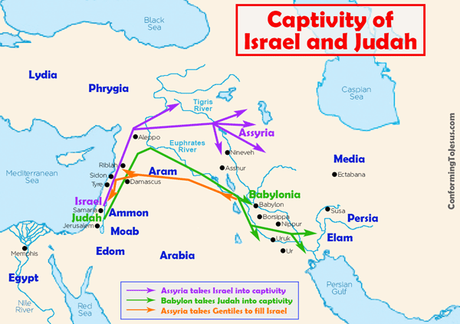
Monarchy map

Slide 12
Monarchy themes
Loss of territorial integrity
Skirmishes with neighbors (Edom, Moab, etc)
Geopolitical stage: alliances with Egypt, Babylon
Cooperation/conflict btw Isr and Judah
Tribute, taxes, temple treasure

Slide 13
Religious themes
Israelites are sycretists, but God is not!
Improper additions:
High places, sacred poles, child sacrifice
Subtractions:
Temple treasures used as tribute
Repentance/forgiveness divine justice/mercy

Slide 14
Fall of Israel
Assyria appears on the scene
Menahem (n) pays tax
Pekah (n) loses territory
Ahaz (s) appeals for relief from Edom/Isr.
Hoshea (n) becomes vassal
922: Assyrians besiege Samaria
Captures and carries off king and people
Brought other peoples to live in the land

Slide 15
Discussion
1 Kings 17:7-23
How does the text make sense of what has happened to Israel?

Slide 16
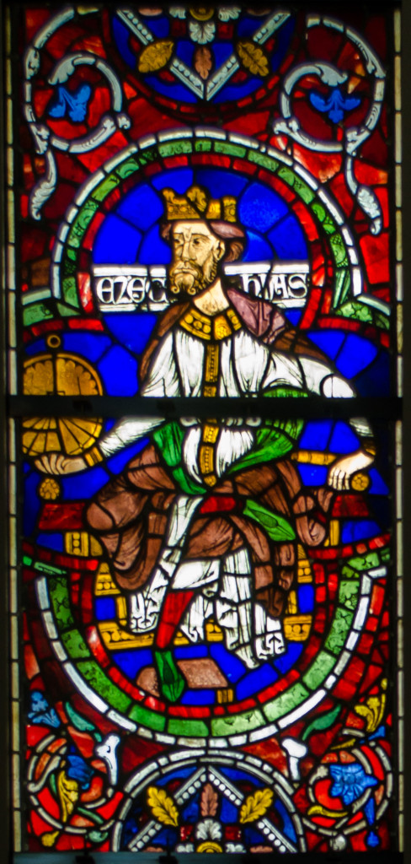
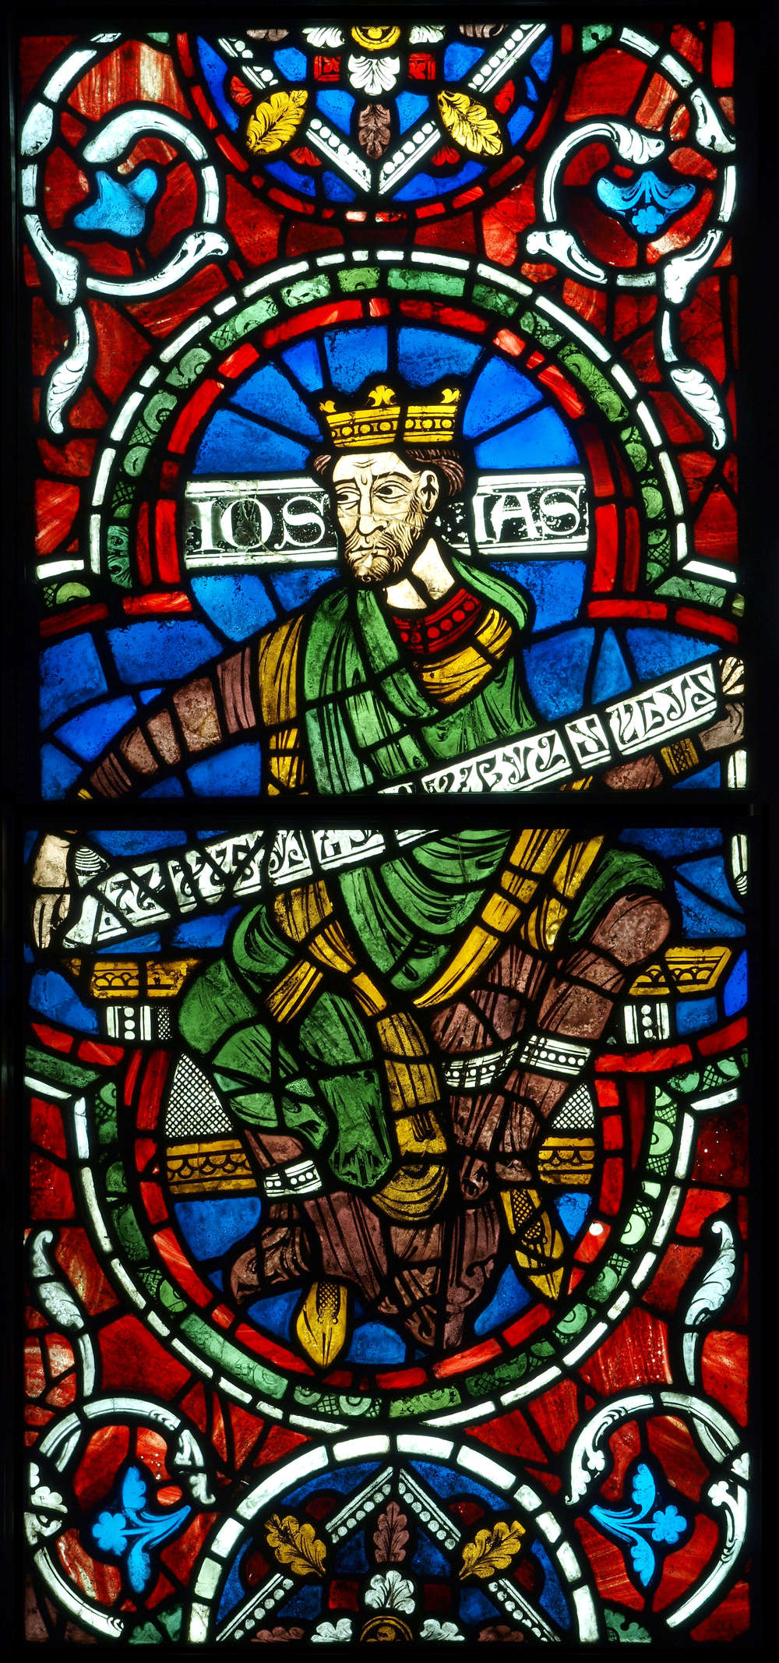
Two Good Kings

Slide 17
Discussion
What were positives and negatives of Hezekiah’s reign?

Slide 18
Hezekiah
Positive
Removed high places, pillars & sacred poles
Removed Moses’ bronze serpent
Held fast to Lord’s commandments
Wouldn’t serve Assyria
Consults Isaiah, repents; God hears prayer
Pool/conduit to bring water to city

Slide 19
Hezekiah
Negative
Uses temple gold as tribute for Assyria (18:14-16)
Shows Babylonian envoys the treasures of Jerusalem
Not bothered by long-term legacy; relieved that Babylonians won’t come in his lifetime

Slide 20
Josiah
Walks in the way of David
Temple restoration project—book is discovered
Deuteronomy or proto-Deuteronomy
Reading, repentance, covenant renewal
Passover observance
Yet: God determined to punish sins of Manasseh

Slide 21
Fall of Judah
Final three kings
Jehoiakim
Jehoiachin
Zedekiah

Slide 22
Fall of Judah
Jehoiakim
Installed by Pharoah
Gave silver & gold to Pharoah, taxed land for tribute
Became Nebuchadnezzar’s servant
Rebelled against Babylon
Babylonians & other neighbors attack Judah

Slide 23
Fall of Judah
Jehoiachin
Babylon besieged Jerusalem
Gives up self, family, officials—taken to Babylon
Babylon captures temple treasures
Kidnapped officials, warriors, artisans, men of valor

Slide 24
Fall of Judah
Zedekiah
Installed by Nebuchadnezzar
Rebels
Siege of Jerusalem—destruction, trauma
Sons killed; blinded; led away
Destruction of temple, king’s house, city
Remaining pop (except some poor laborers) brought into exile

Slide 25
Moving Forward
Assignment for next time: Ezra & Nehemiah
Return & rebuilding: center and edges
Opening prayer for next time: _______

