Slide 1
HO
Exploring the Old Testament:
A Biblical Survey
First Presbyterian Church of Tallahassee
Wednesdays 5:45-6:45 p.m.
Rev. Margaret Fox
Notes:
Pause screen share, welcome class, pray

Slide 2
Prayer for illumination

Slide 3
Today’s class:
1 Kings 2-22
Notes:
START with homework questions

Slide 4
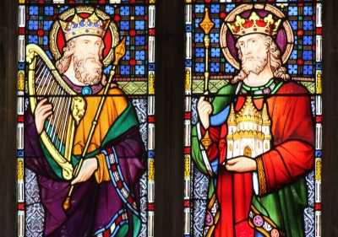
Notes:
START with homework questions

Slide 5
What’s new?
Who is God?
Creator, covenant maker, warrior… lawgiver, commander, enforcer, tactician & general, rescuer/punisher, fertility specialist, ark-dweller, kingmaker & king un-maker, dynasty founder, resident of Jerusalem
Who is Israel?
Family lineage, slaves, fugitives, covenant people, soldiers & settlers, apostates and tribal lords, open and accepting people, proto-monarchy, monarchy, divided monarchy

Slide 6
Rise & Fall of United Monarchy
Outline:
Kingship of Solomon (2-11)
Divided Monarchy (12-16, 22)
Prophetic tales from Northern Kingdom (17-21)

Slide 7
Wisdom of Solomon
Asks for wisdom, gets wisdom + wealth and honor
Composed proverbs & psalms
Natural knowledge of plants & animals
International renown for wisdom

Slide 8
Achievements of Solomon
Bureaucracy and system of taxation
Territorial integrity
Safety--“under own vine and fig tree”
Peace w/King Hiram of Tire
Temple and other building projects
Military: fleet of ships; horses & chariots

Slide 9
Theological Frame
God resides in temple
Ark
Cloud
Sacrifice
Covenant with David
Solomon’s prayer

Slide 10
Fall of Solomon
Theological
Marriage to Egyptian wife & foreign women
Turned his heart after foreign gods, built “high places”
Geo-political
Gives Hiram of Tire 20 cities in Galilee (was he overextended in building projects?)
Forced labor

Slide 11
Questions
Genre: How is this similar to / different from David story?
What patterns did you notice from the homework?

Slide 12
Divided kingdom
God’s punishment for Solomon’s infidelity (to God)
Jeroboam, servant of Solomon, rebels against Reheboam, son of Solomon
Division into northern kingdom (Israel) and southern (Juda)

Slide 13
Divided kingdom
Patterns:
Formulaic summary: king, kingdom, length of reign. Mother (if from Judah). “He did what was evil in the sight of the Lord.”
Idolatry as primary metric

Slide 14
Prophetic Folktales
How does genre shift again with stories of the prophets in chapter 17?

Slide 15
Prophetic Folktales
Source is northern
Geography of God:
Mt Carmel, Beersheeba, Mt. Horeb, etc.
Power of God: miracles
What roles do prophets play?

Slide 16
Moving Forward
Assignment for next time:
Annals of the kings of Israel
Opening prayer for next time: _______

