Slide 1
HO
Exploring the Old Testament:
A Biblical Survey
First Presbyterian Church of Tallahassee
Wednesdays 5:45-6:45 p.m.
Rev. Margaret Fox
Notes:
Pause screen share, welcome class, pray

Slide 2
Prayer for illumination
Deborah Wishnant

Slide 3
Today’s class:
1 Samuel 9-11, 13-31
2 Samuel 1
Notes:
START with homework questions

Slide 4
What’s new?
Who is God?
Creator, covenant maker, warrior… lawgiver, commander, enforcer, tactician & general, rescuer/punisher, fertility specialist, ark-dweller, kingmaker
Who is Israel?
Family lineage, slaves, fugitives, covenant people, soldiers & settlers, apostates and tribal lords, open and accepting people, proto-monarchy, monarchy

Slide 5
Rise & Fall of King Saul
Unintentional king
Out looking for donkeys
“I am only a Benjaminite”
Doesn’t tell about first anointing
Second anointing—chosen by lot--hides

Slide 6
Rise & Fall of King Saul
Perpetually uninformed
Can’t find donkeys
Where is Samuel at Gibeah?
God’s silence (ch. 14) after Jonathan eats honey
Doesn’t know David is a threat
Doesn’t know Jonathan is helping David

Slide 7
Rise & Fall of King Saul
Successes:
Recruiting—builds army of strong warriors
Mustering against the Ammonites
Military success: Moab, Ammon, Edom, Zobah, Philistines, Amalekites…

Slide 8
Rise & Fall of King Saul
Tragically merciful
Doesn’t kill opponents when first anointed
Kenites flee, captures Agag, keeps animals
Accidentally incubates young David, repeatedly forgives him

Slide 9
Rise & Fall of King Saul
Tries & fails to be pious
Sacrifices on his own when Samuel is late to meet him
Keeps Amalekites’ sheep/cattle to sacrifice to the Lord—but this is disobedience
Bans mediums/wizards, but then hires medium of Endor to consult dead Samuel

Slide 10
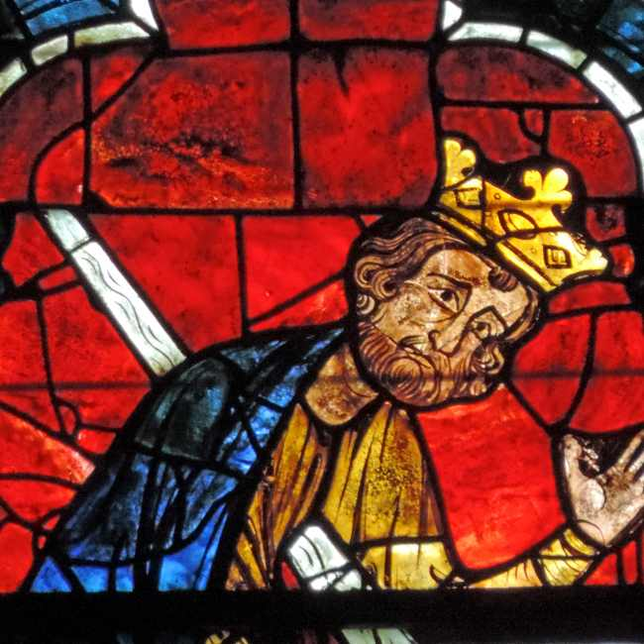
Rise & Fall of King Saul

Slide 11
Articles of Impeachment
RESOLUTION
Impeaching Saul, first monarch of the United Kington of Israel. for high crimes and misdemeanors
Resolved, that King Saul of Israel is impeached for high crimes and misdemeanors and that the following article of impeachment be exhibited to the Israelite Senate for their removal action.

Slide 12
ARTICLE 1: DISOBEYING GOD’S WISHES
He violated the covenant between Israel and God on at least two occasions. He disobeyed orders delivered by Samuel and conducted sacrifices instead of waiting for Samuel to arrive in Gilgal. He let King Agag and his prime animals live when God, speaking through Samuel, ordered all humans and animals in Amalek should die.
In all of this, King Saul has acted in a manner contrary to his covenant with the Lord God who selected him for this position. Wherefore, King Saul, by such conduct, has demonstrated that he will remain a threat to the kingdom of Israel if allowed to remain in office, and has acted in a manner grossly incompatible with expectations of an obedient servant to the Lord God. King Saul thus warrants impeachment and trial, removal from office, and disqualification to hold and enjoy any office of honor, trust, or profit under the United Nation of Israel.

Slide 13
ARTICLE 2: ABUSE OF POWER: ENDEAVORING TO ELIMINATE HIS SUCCESSOR, DAVID AND ORDERING THE DEATHS OF PRIESTS AT NOB.
Using the powers of his high office, he ordered the elimination of David on at least five occasions and attempted bodily harm to David by his own sword at least three times. He ordered the deaths of priest Ahimelech and other priests at Nob who helped David when he was fleeing from Saul.
In all of this, King Saul abused the powers of the monarchy by ordering the death of one of his subjects and attempting to kill that subject himself. Wherefore King Saul, by such conduct, has demonstrated that he will remain a threat to the nation of Israel if allowed to remain in office, and has acted in a manner grossly incompatible with leadership of God’s people. King Saul thus warrants impeachment and trial, removal from office, and disqualification to hold and enjoy any office of honor, trust, or profit under the United Nation of Israel.

Slide 14
Problems of King David
No hereditary right to throne
Mob leader who plunders and extorts (ie Nabal)
Collaborator with Philistines
Always has almost-dirty hands

Slide 15
King David
Double-talk
Goliath chapter: asks about rewards, but projects patriotism and piety
Twice spares Saul’s life—always saves evidence
Restrains himself from killing Nabal, who conveniently drops dead
Pretends to raid Judean towns while working for King Achish of Gath
Kills Amalekite who killed Saul
Song of praise to Saul

Slide 16
Moving Forward
Next meeting January 12
Assignment for next time:
First paragraph of King David’s obituary
Opening prayer for next time: _______

