Slide 1
HO
Exploring the Old Testament:
A Biblical Survey
First Presbyterian Church of Tallahassee
Wednesdays 5:45-6:45 p.m.
Rev. Margaret Fox
Notes:
Pause screen share, welcome class, pray

Slide 2
Prayer for illumination
Tip Tomberlin

Slide 3
Today’s class:
1 Samuel 1-8, 12
Notes:
START with homework questions

Slide 4
What’s new?
Who is God?
Creator, covenant maker, warrior… lawgiver, commander, enforcer, tactician & general, rescuer/punisher, fertility specialist, ark-dweller
Who is Israel?
Family lineage, slaves, fugitives, covenant people, soldiers & settlers, apostates and tribal lords, open and accepting people, proto-monarchy

Slide 5
Continuity – 1 Sam. 7:15
“Samuel judged Israel all the days of his life…”
Samuel as last judge/first prophet

Slide 6
Composition
Deuteronomistic writer/redactor
“Ark narrative”
Notes:
\

Slide 7
Composition
Deuteronomistic writer/redactor
Central worship in Jerusalem
Davidic kingship
Covenant with God
Notes:
\

Slide 8
Composition
“Ark narrative”
Human agents on the sidelines
Decisive, miraculous intervention by God
NOT about central cult or king
Notes:
\

Slide 9
Samuel Story

Slide 10
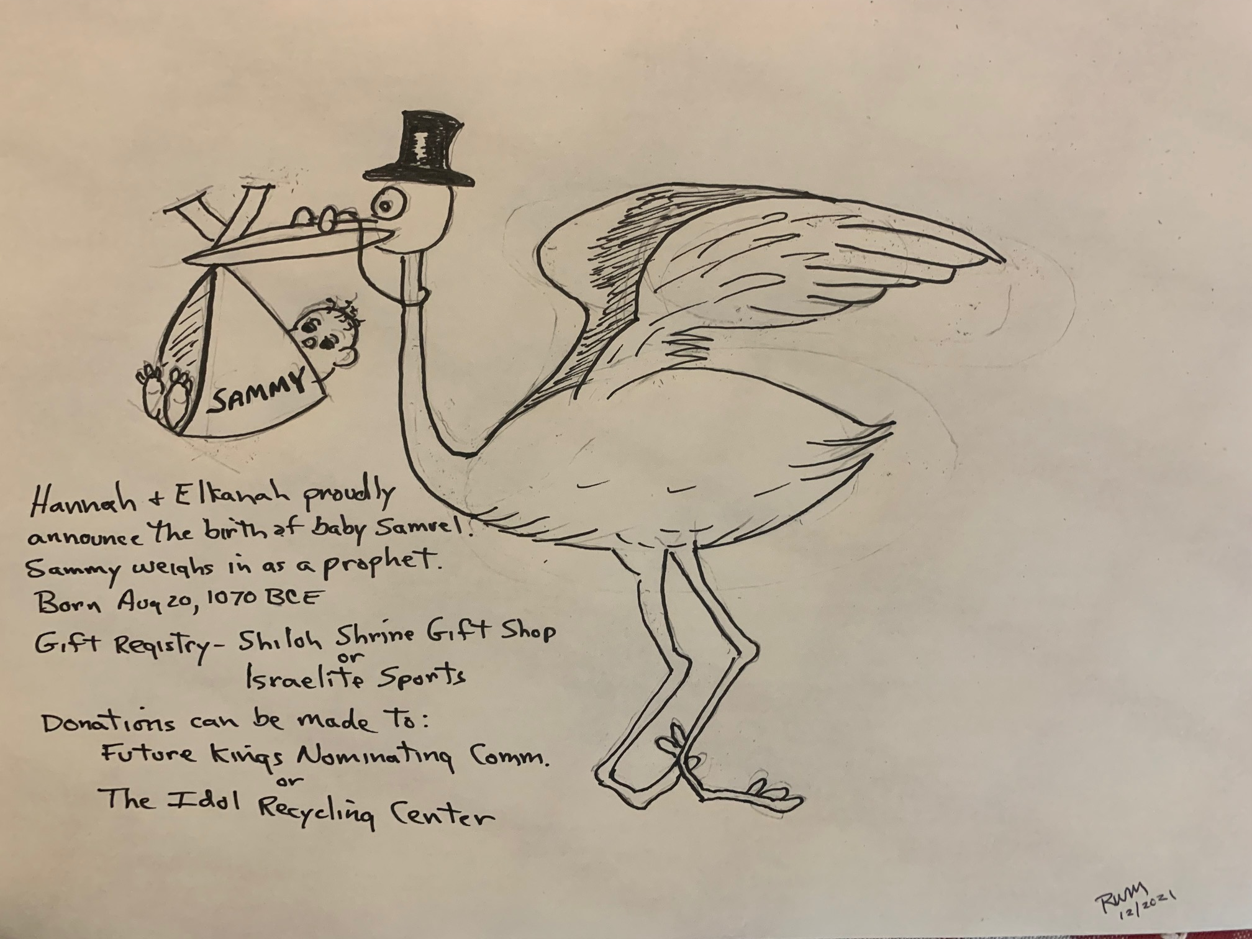
Samuel Story

Slide 11
Praise be to the Lord!
He has answered our petitions!
Elkanah and Hannah
thankfully announce the birth of their son
Samuel
Date: 3 nights after last full moon
Weight: 97 dove eggs
Length: 3 of Elkanah’s palms
Please note: Amazon has been notified that all gifts ordered after a to-be-determined date will be sent in care of Eli to The House of the Lord in Shiloh, because we will lend Samuel to the Lord for the rest of his days.
Praise be to God for He has done wonderful things!

Slide 12
When Samuel was born, she said words of Torah,
“For this lad I prayed.”
When he grew up and did the deeds of his life,
She asked, “for this lad I prayed?”
--Yehuda Amichai

Slide 13
Mixed legacy of Samuel
Both patriotism and self-interest
Truth-teller to Eli, but own sons corrupt
For next week: when does Samuel speak for himself, and when does he speak for God?

Slide 14
First Look at Monarchy
Judges chapter 9:7-15 – Jotham’s parable
Context: Abimlech’s pretension to kingship

Slide 15
Moving Forward
Assignment for next week:
Impeach King Saul
Opening prayer for next week: _______

