Slide 1
HO
Exploring the Old Testament:
A Biblical Survey
First Presbyterian Church of Tallahassee
Wednesdays 5:45-6:45 p.m.
Rev. Margaret Fox
Notes:
Pause screen share, welcome class, pray

Slide 2
Prayer for illumination
Anna Jordan

Slide 3
Today’s class:
Ruth
A very welcome interlude…
Notes:
START with homework questions

Slide 4
What’s new?
Who is God?
Creator, covenant maker, warrior… lawgiver, commander, enforcer, tactician & general, rescuer/punisher, ?
Who is Israel?
Family lineage, slaves, fugitives, covenant people, soldiers & settlers, apostates and tribal lords, open and accepting people

Slide 5
Continuity – Ruth 1:1
“In the days when the judges ruled, there was a famine in the land, and a certain man of Bethlehem in Judah went to live in the country of Moab, with his wife and two sons…”

Slide 6
Contrast
How does Ruth differ from Judges?

Slide 7
Canonicity
Where is Ruth?

Slide 8
Canonicity
Christian Bibles: Between Judges and 1 Samuel
Jewish Bibles: Between Song of Song and Lamentations

Slide 9
The Hebrew Bible
TANAKH =
Torah (5 books of Moses)
Nevi’im (prophets—former and latter)
Ketuvim (writings)
*Ruth included with writings

Slide 10
The Old Testament
Torah (5 books of Moses)
Historical books (Joshua-Esther)
Poetical/wisdom books (Job-Song of Solomon)
Prophets
*Ruth included with historical books
Notes:
Talk about how/why this difference happened – see Miles p. 16
As what difference it makes

Slide 11
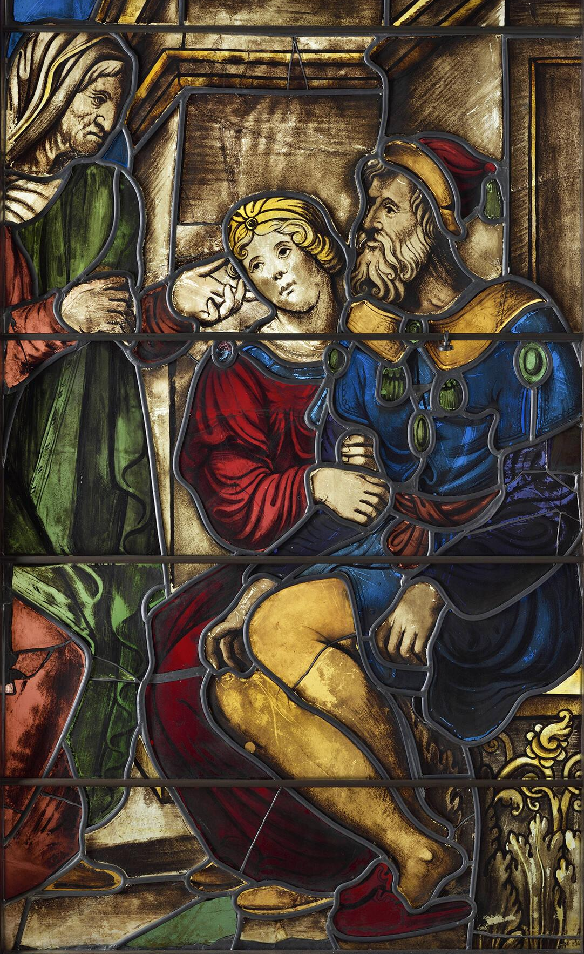
Summary

Slide 12
Context
Who are the Moabites?
Gen. 19: offspring of Lot & his daughter
Num. 22: king Balak of Moab tries to hire Balaam to curse Israel
Num. 25: Lord orders Israelite chiefs impaled on stakes b/c people having sex w/Moabite women
Deut. 2: “No Moabite shall be admitted to the assembly of the Lord…”
Judges 2: King Eglon of Moab (slain by Ehud)

Slide 13
Composition
If before the exile, establishes
Davidic kingship
levirate marriage
virtuous covenant behavior
If after the exile
COUNTER ethno-nationalism of Ezra/Nehemiah: foreigners can be included, too

Slide 14
Covenant
Jewish Liturgical Tradition:
Ruth is read at Pentecost/Weeks
Harvest festival
Commemorates the giving of the Law at Sinai
Notes:
WHY? What’s the connection?

Slide 15
Question
How do ordinary people get into the story of God?
Naomi → complaint
Ruth → asking for what she wants
Boaz → assuming new responsibilities
(from Eugene Peterson, Five Smooth Stones for Pastoral Work)

Slide 16
Moving Forward
Assignment for next week:
Make a birth announcement for Baby Samuel
Opening prayer for next week: _______

